Slide 2

Project
Prototype
Sailesh Rajanala
Computer Science
Lead, UI & UX
Lead

Slide 3





Project
Unified Database
Stores information about Industry Partners
Helps Senior Design Instructors
to gather Sponsored Projects
Industry Partner Database

Slide 4
1
2
3
Webpage - Web Form
(Input for Database)
Database
Data Table
Webpage - Contacts List
(Output from Database)

Slide 6
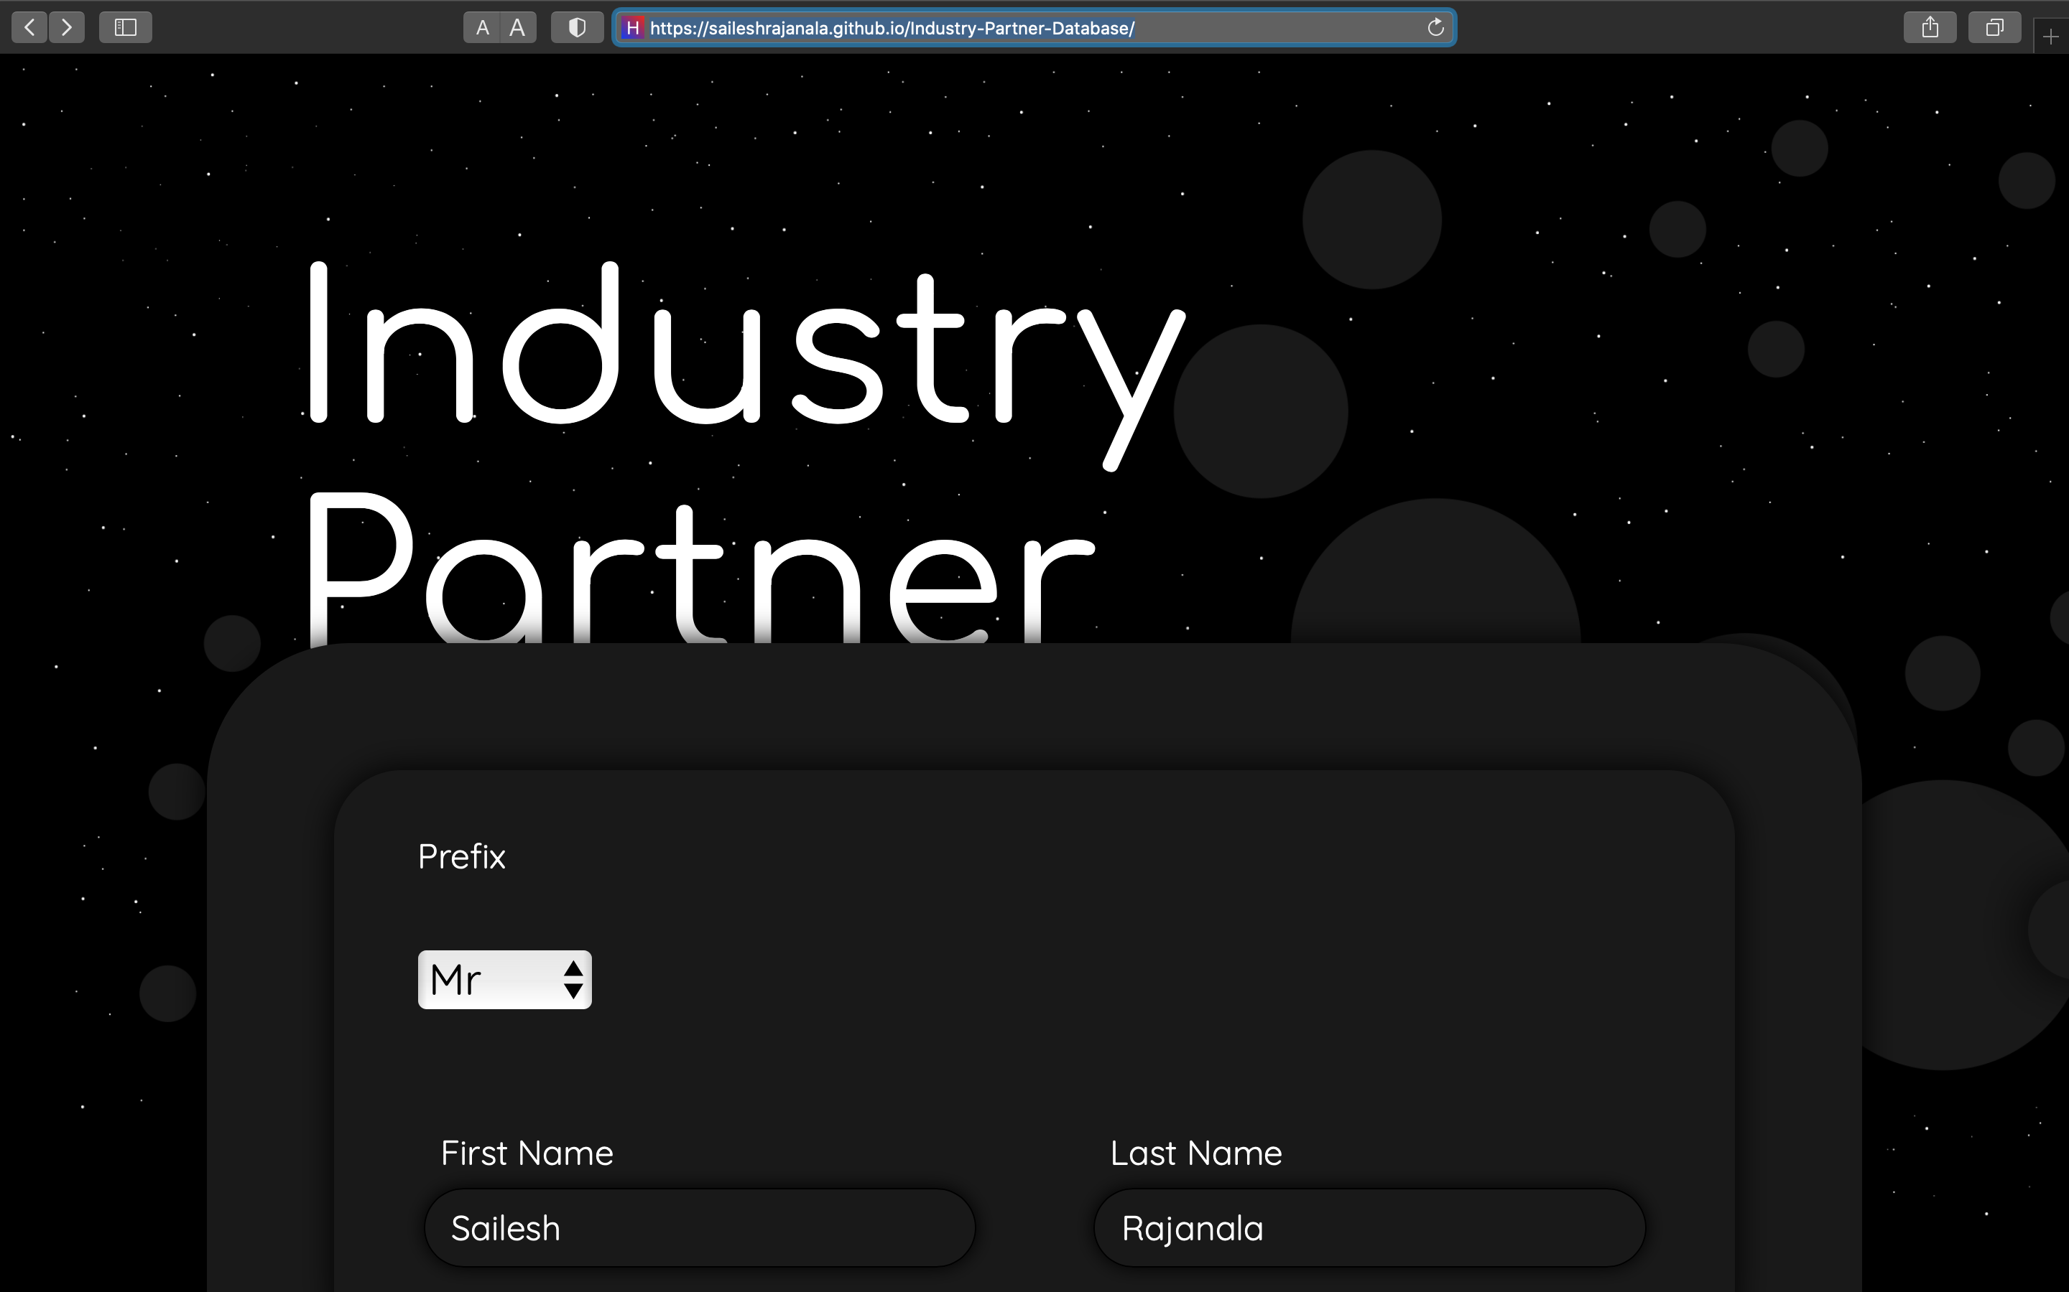
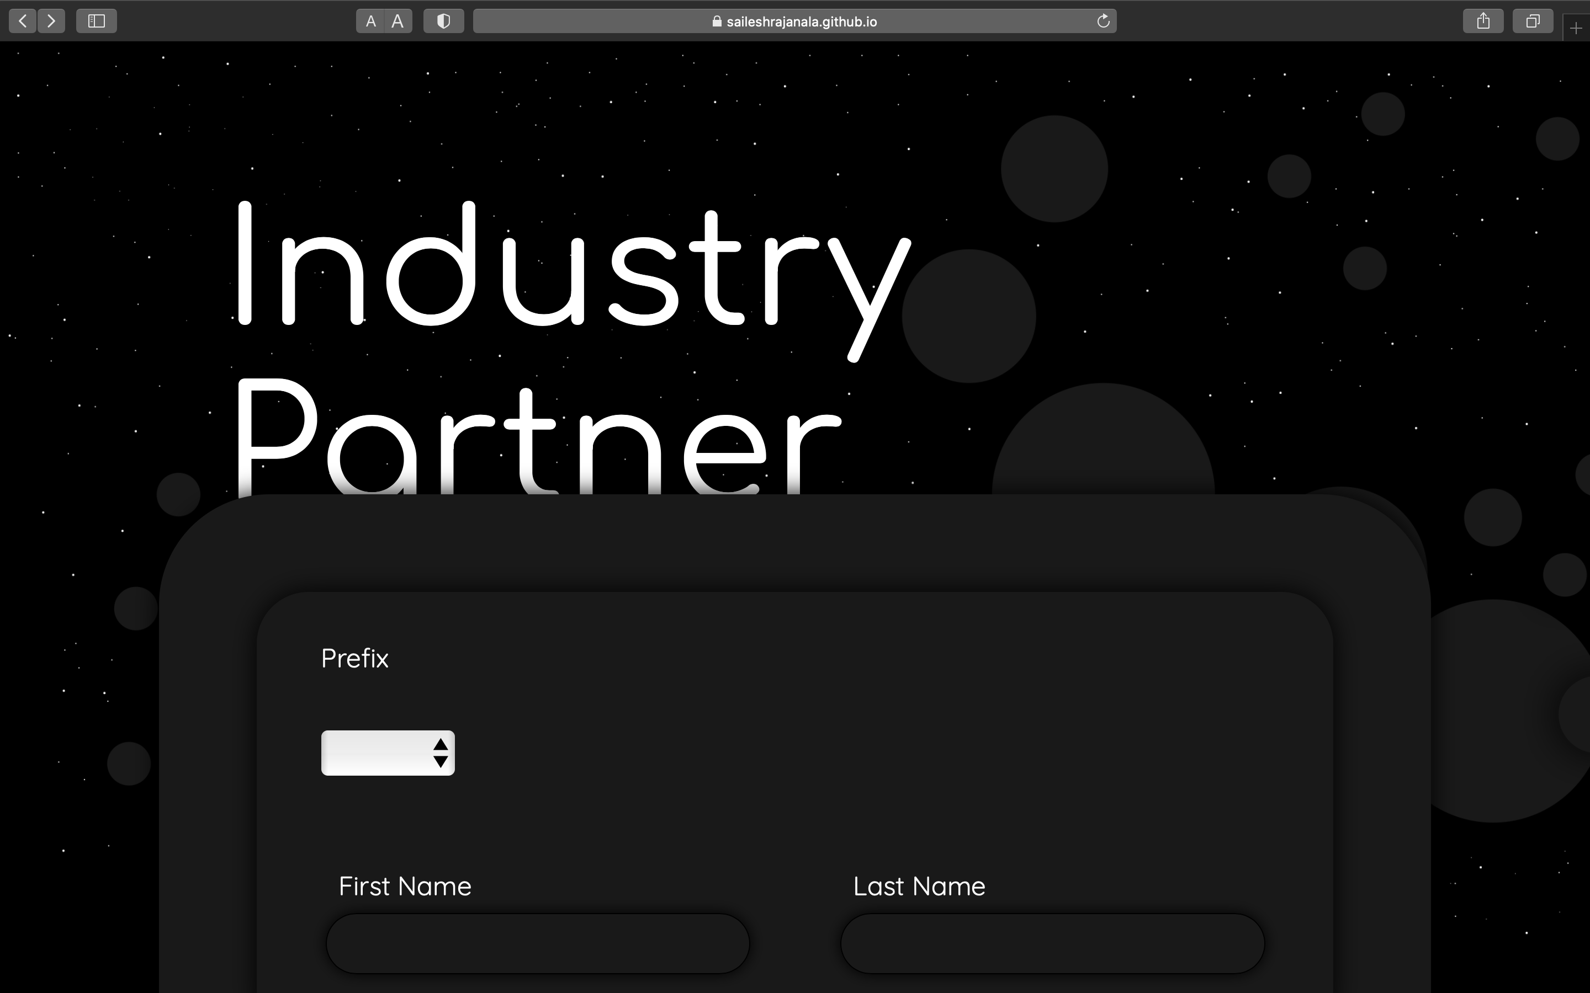

Slide 7
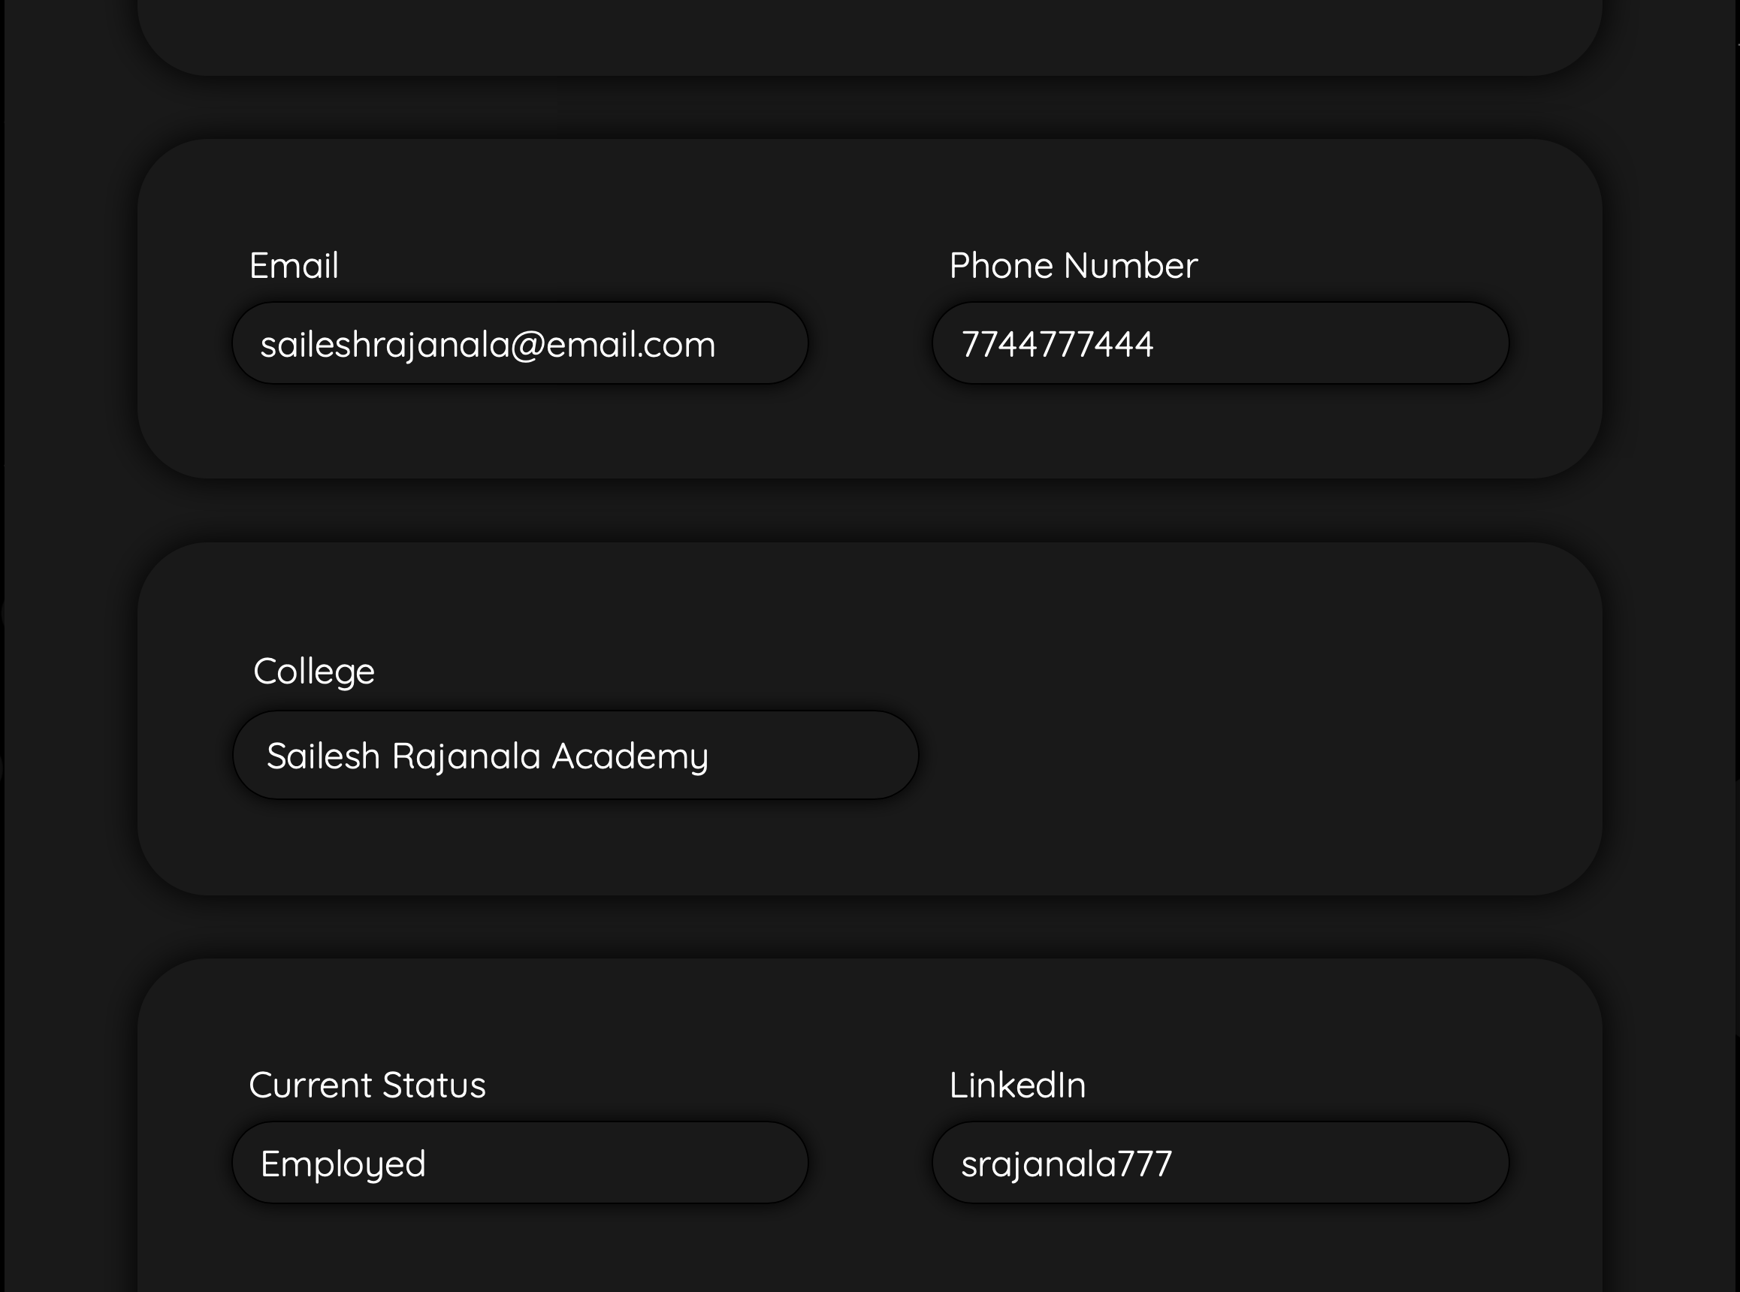
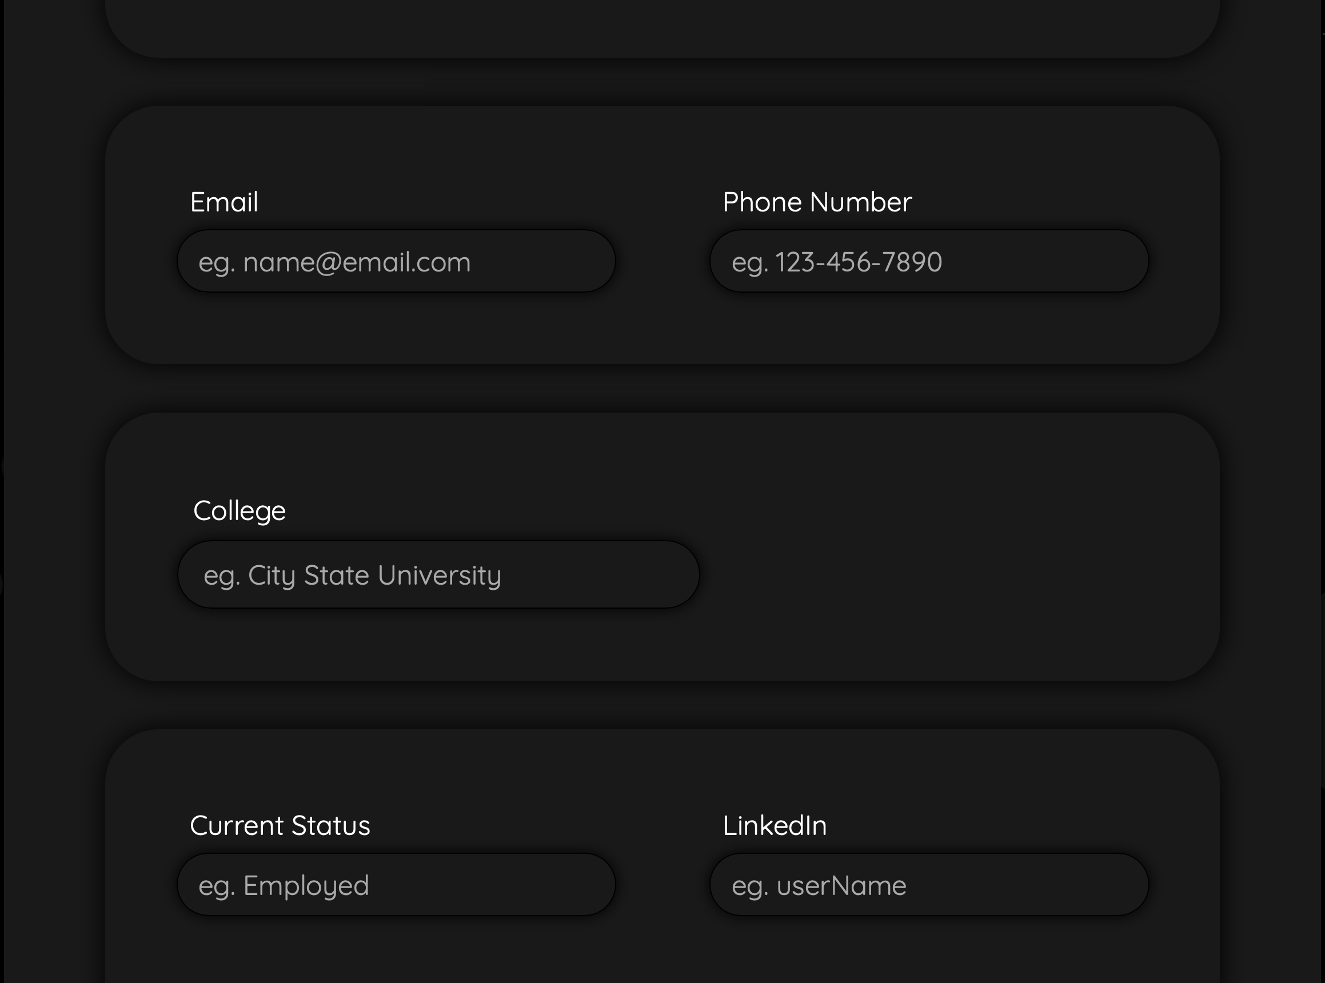

Slide 8
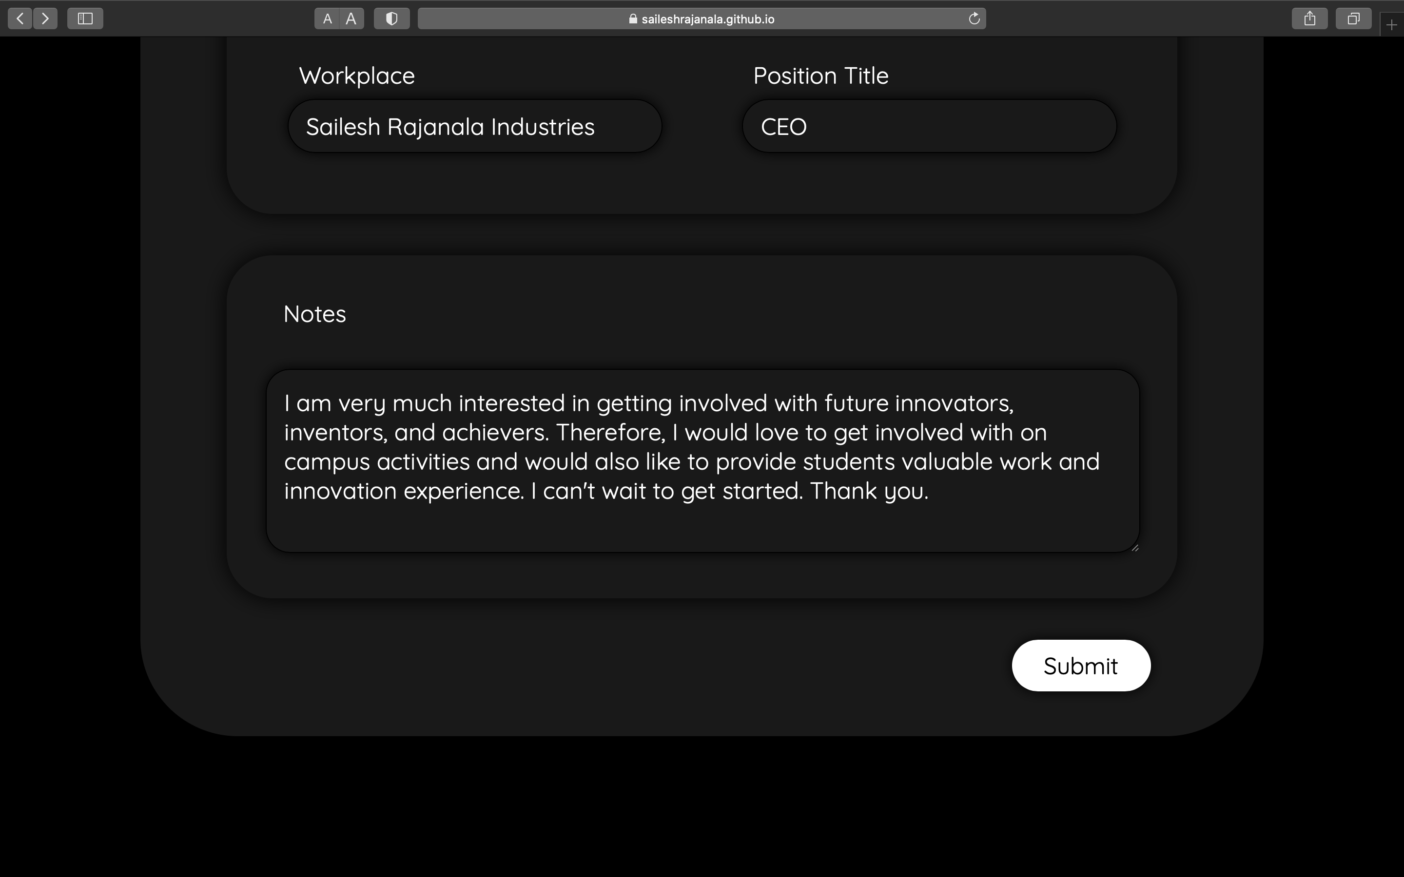
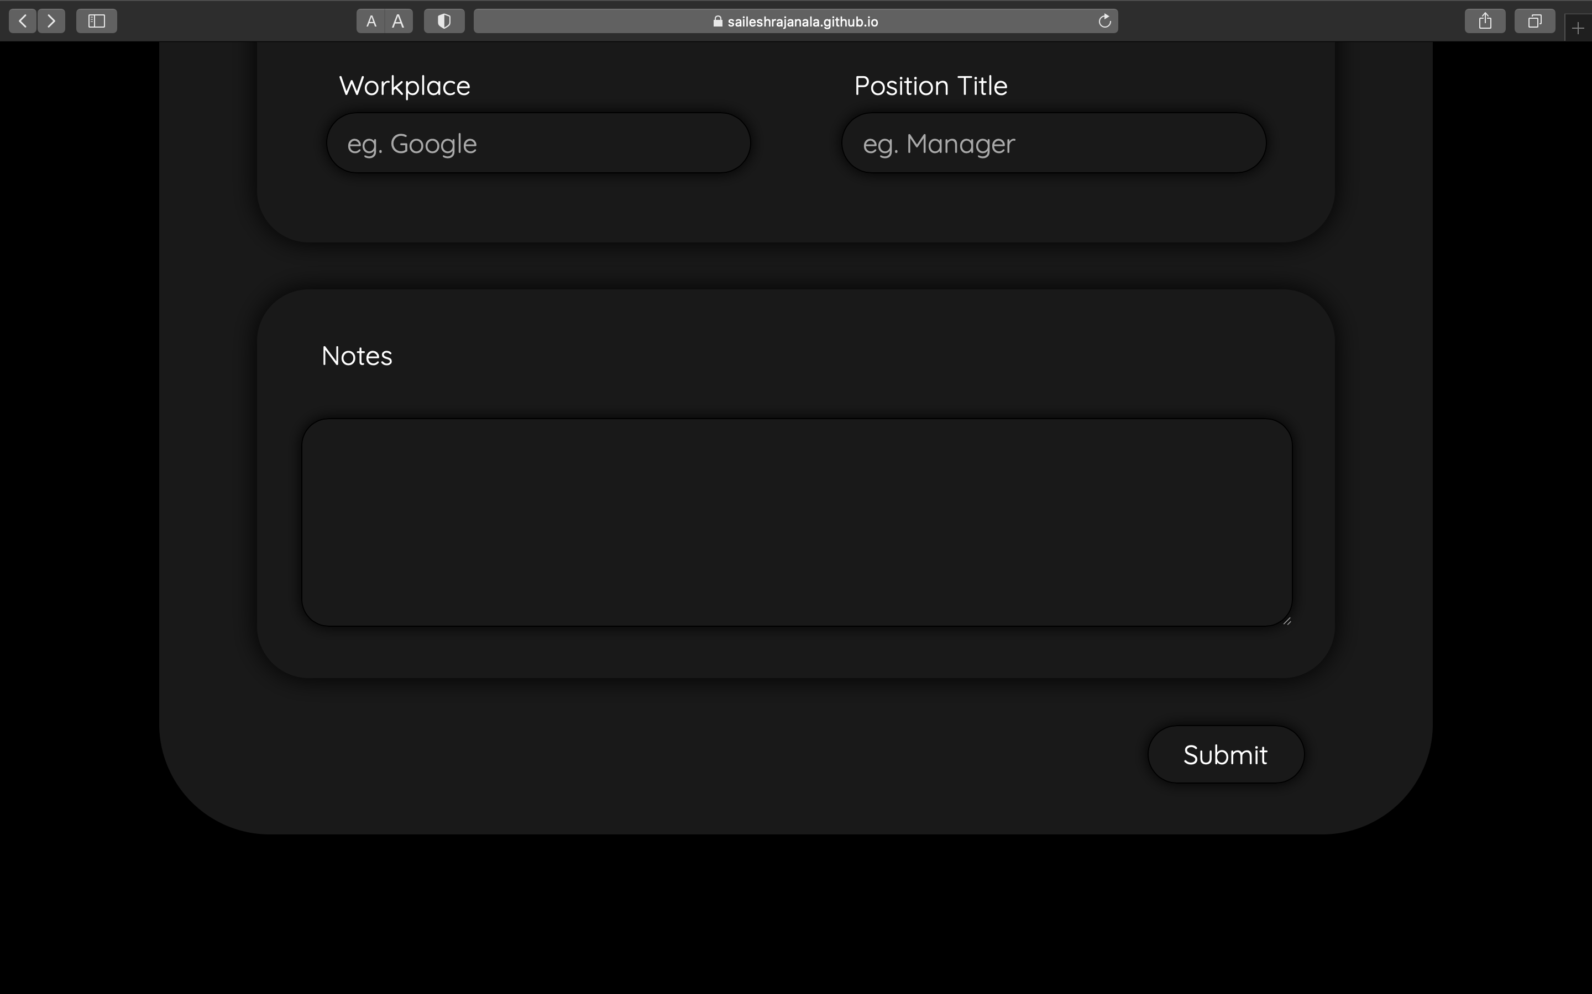

Slide 9
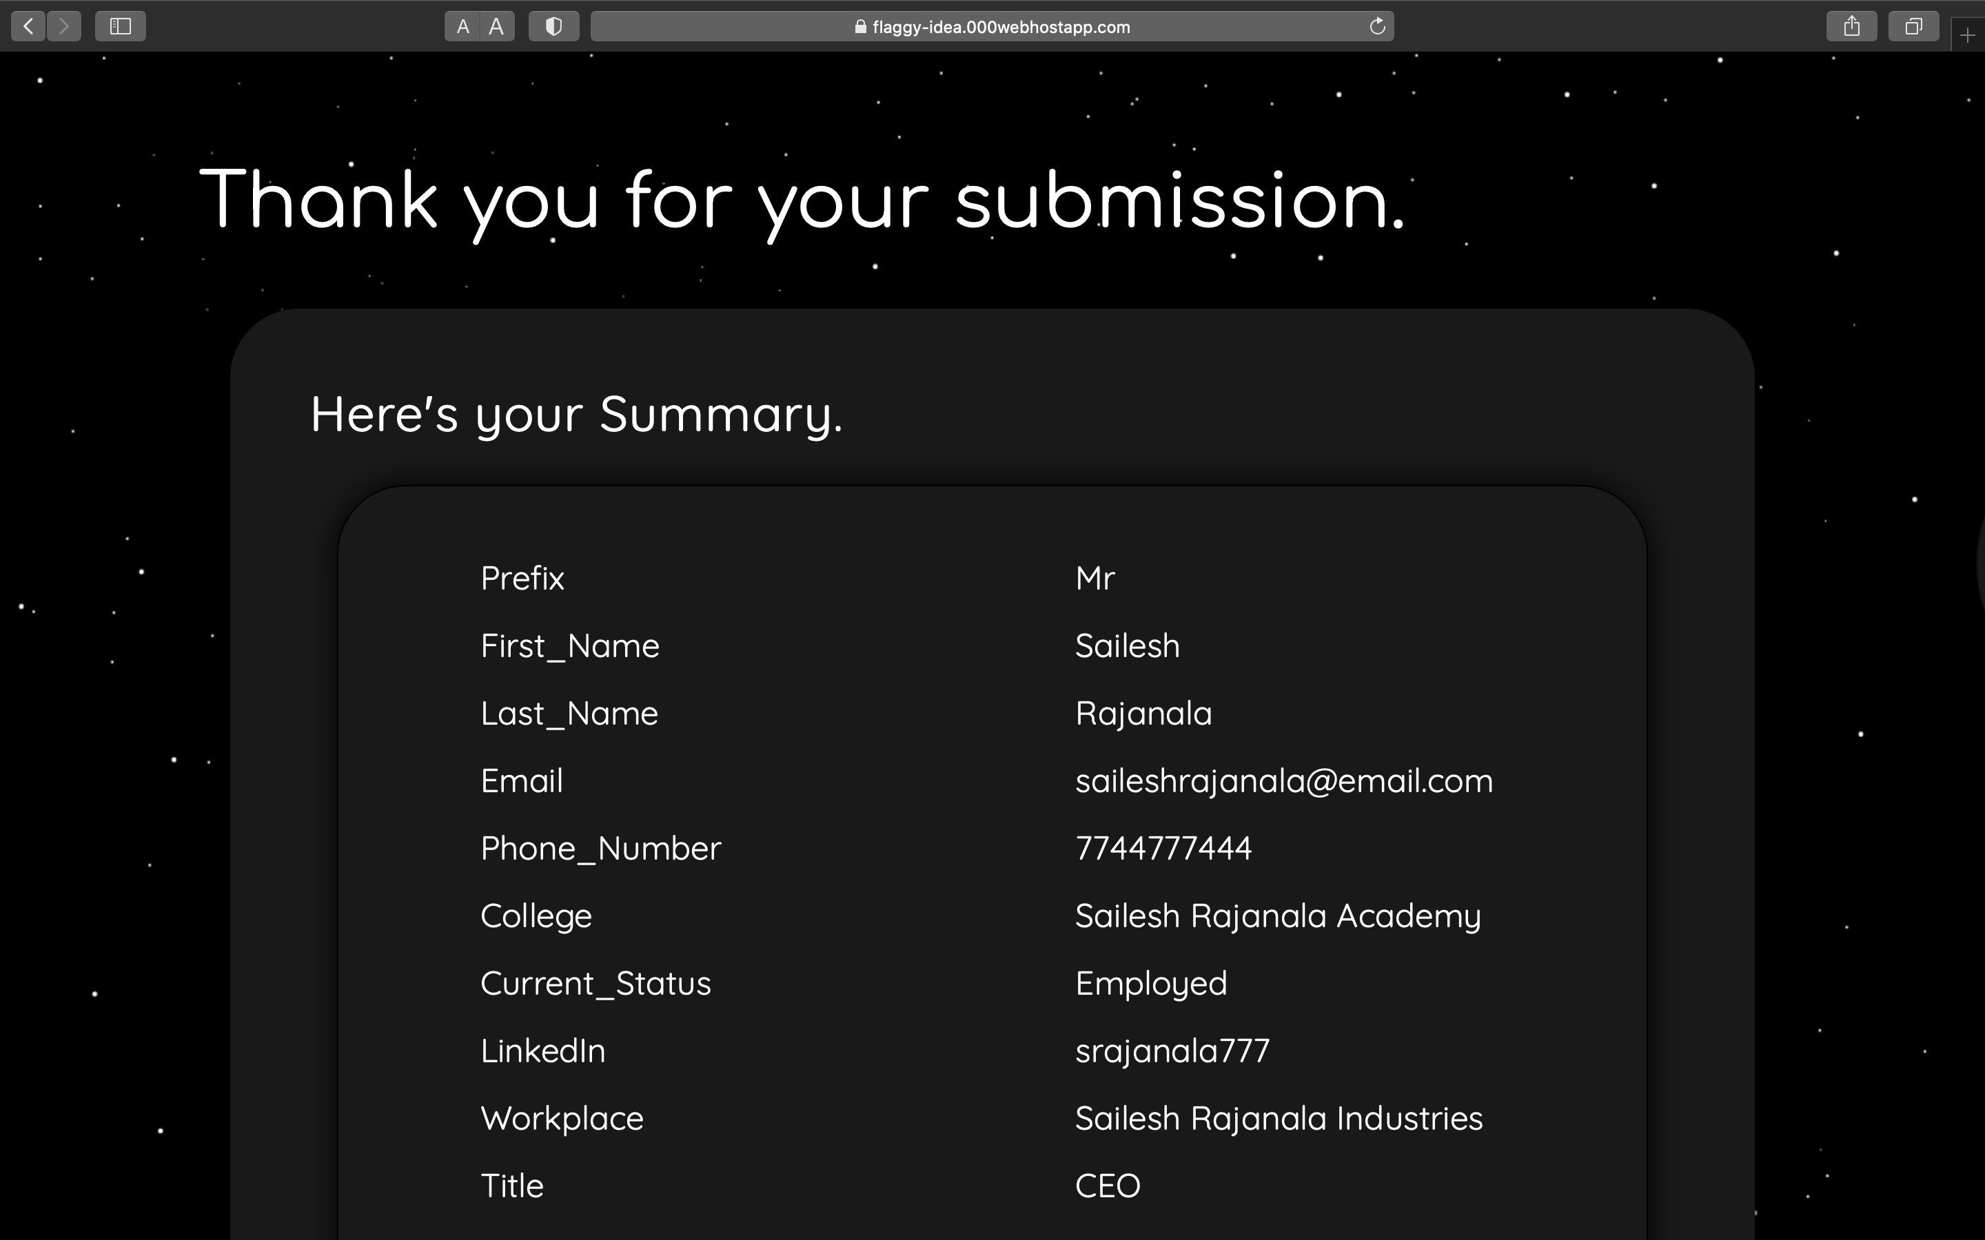

Slide 10
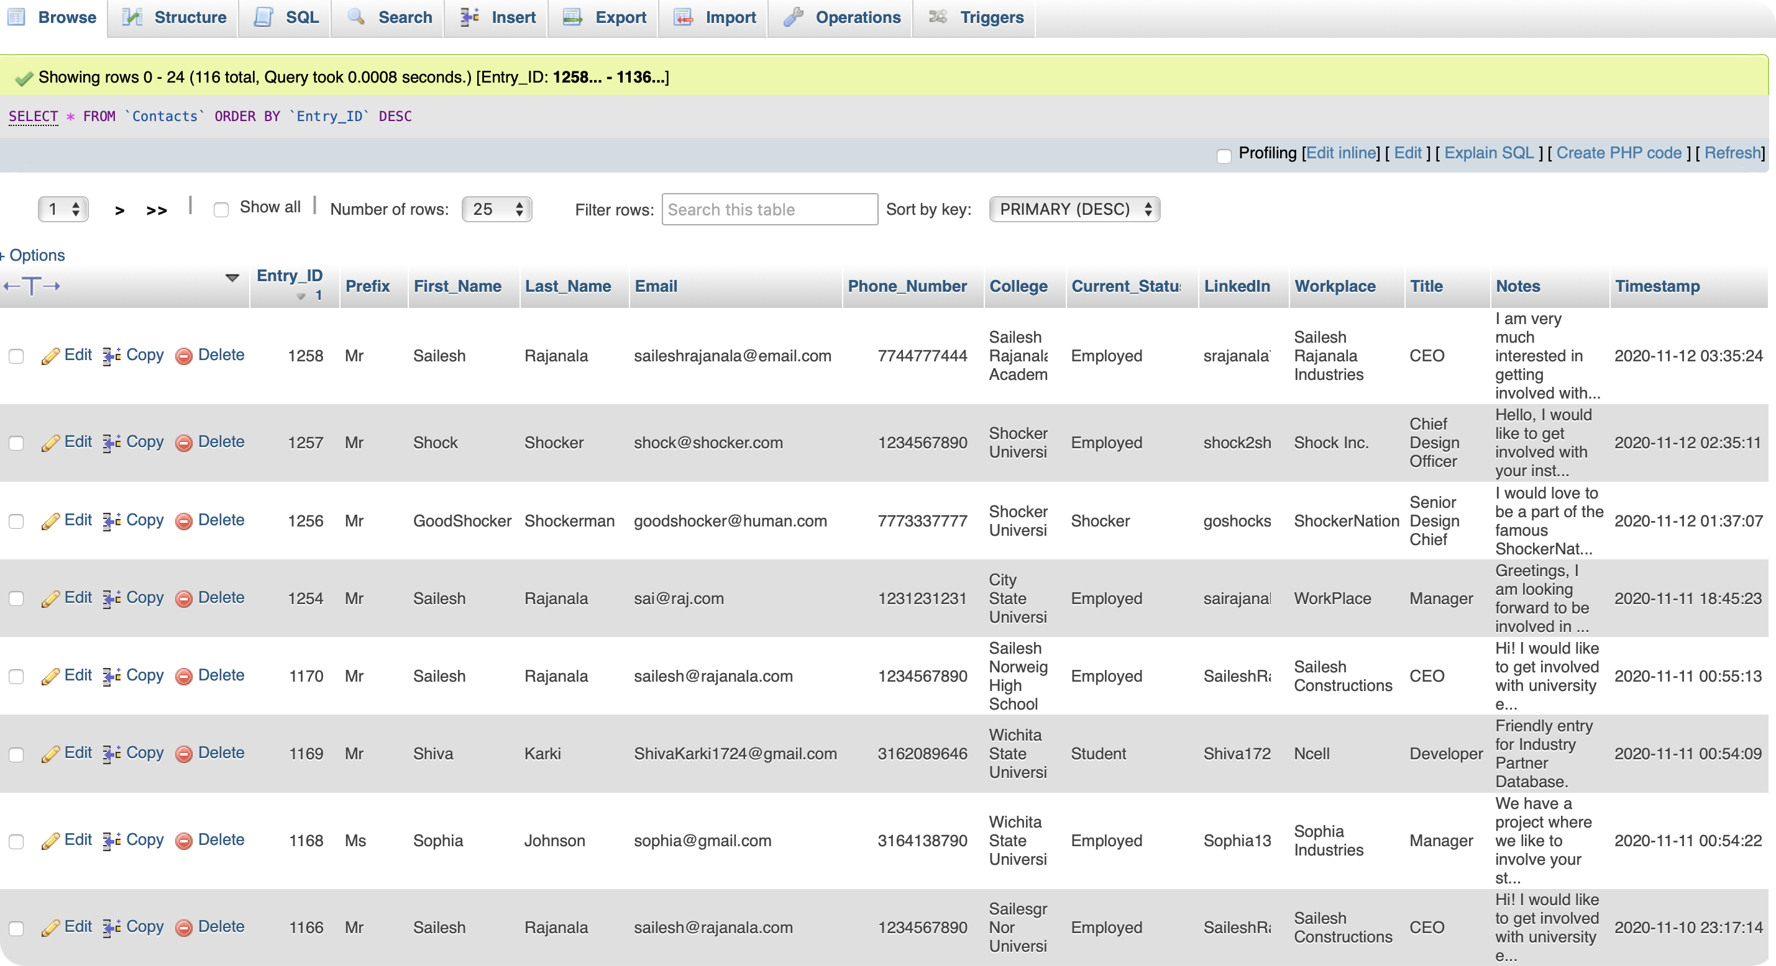
phpMyAdmin
Database of Industry Contacts
MariaDB, InnoDB, MySQL
Database - (phpMyAdmin)

Slide 11
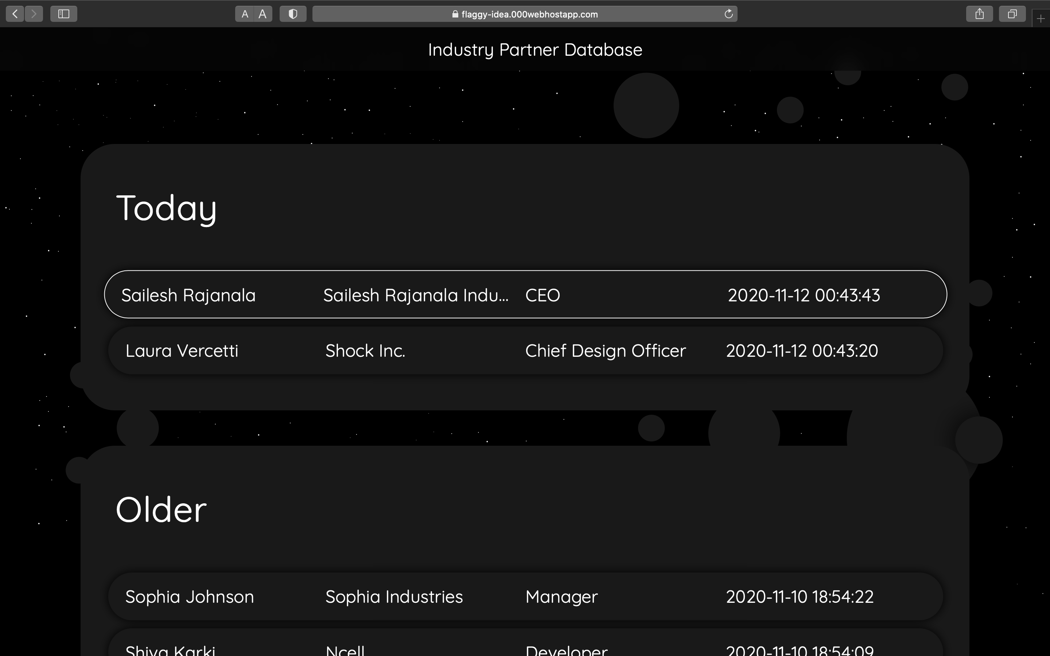

Slide 12
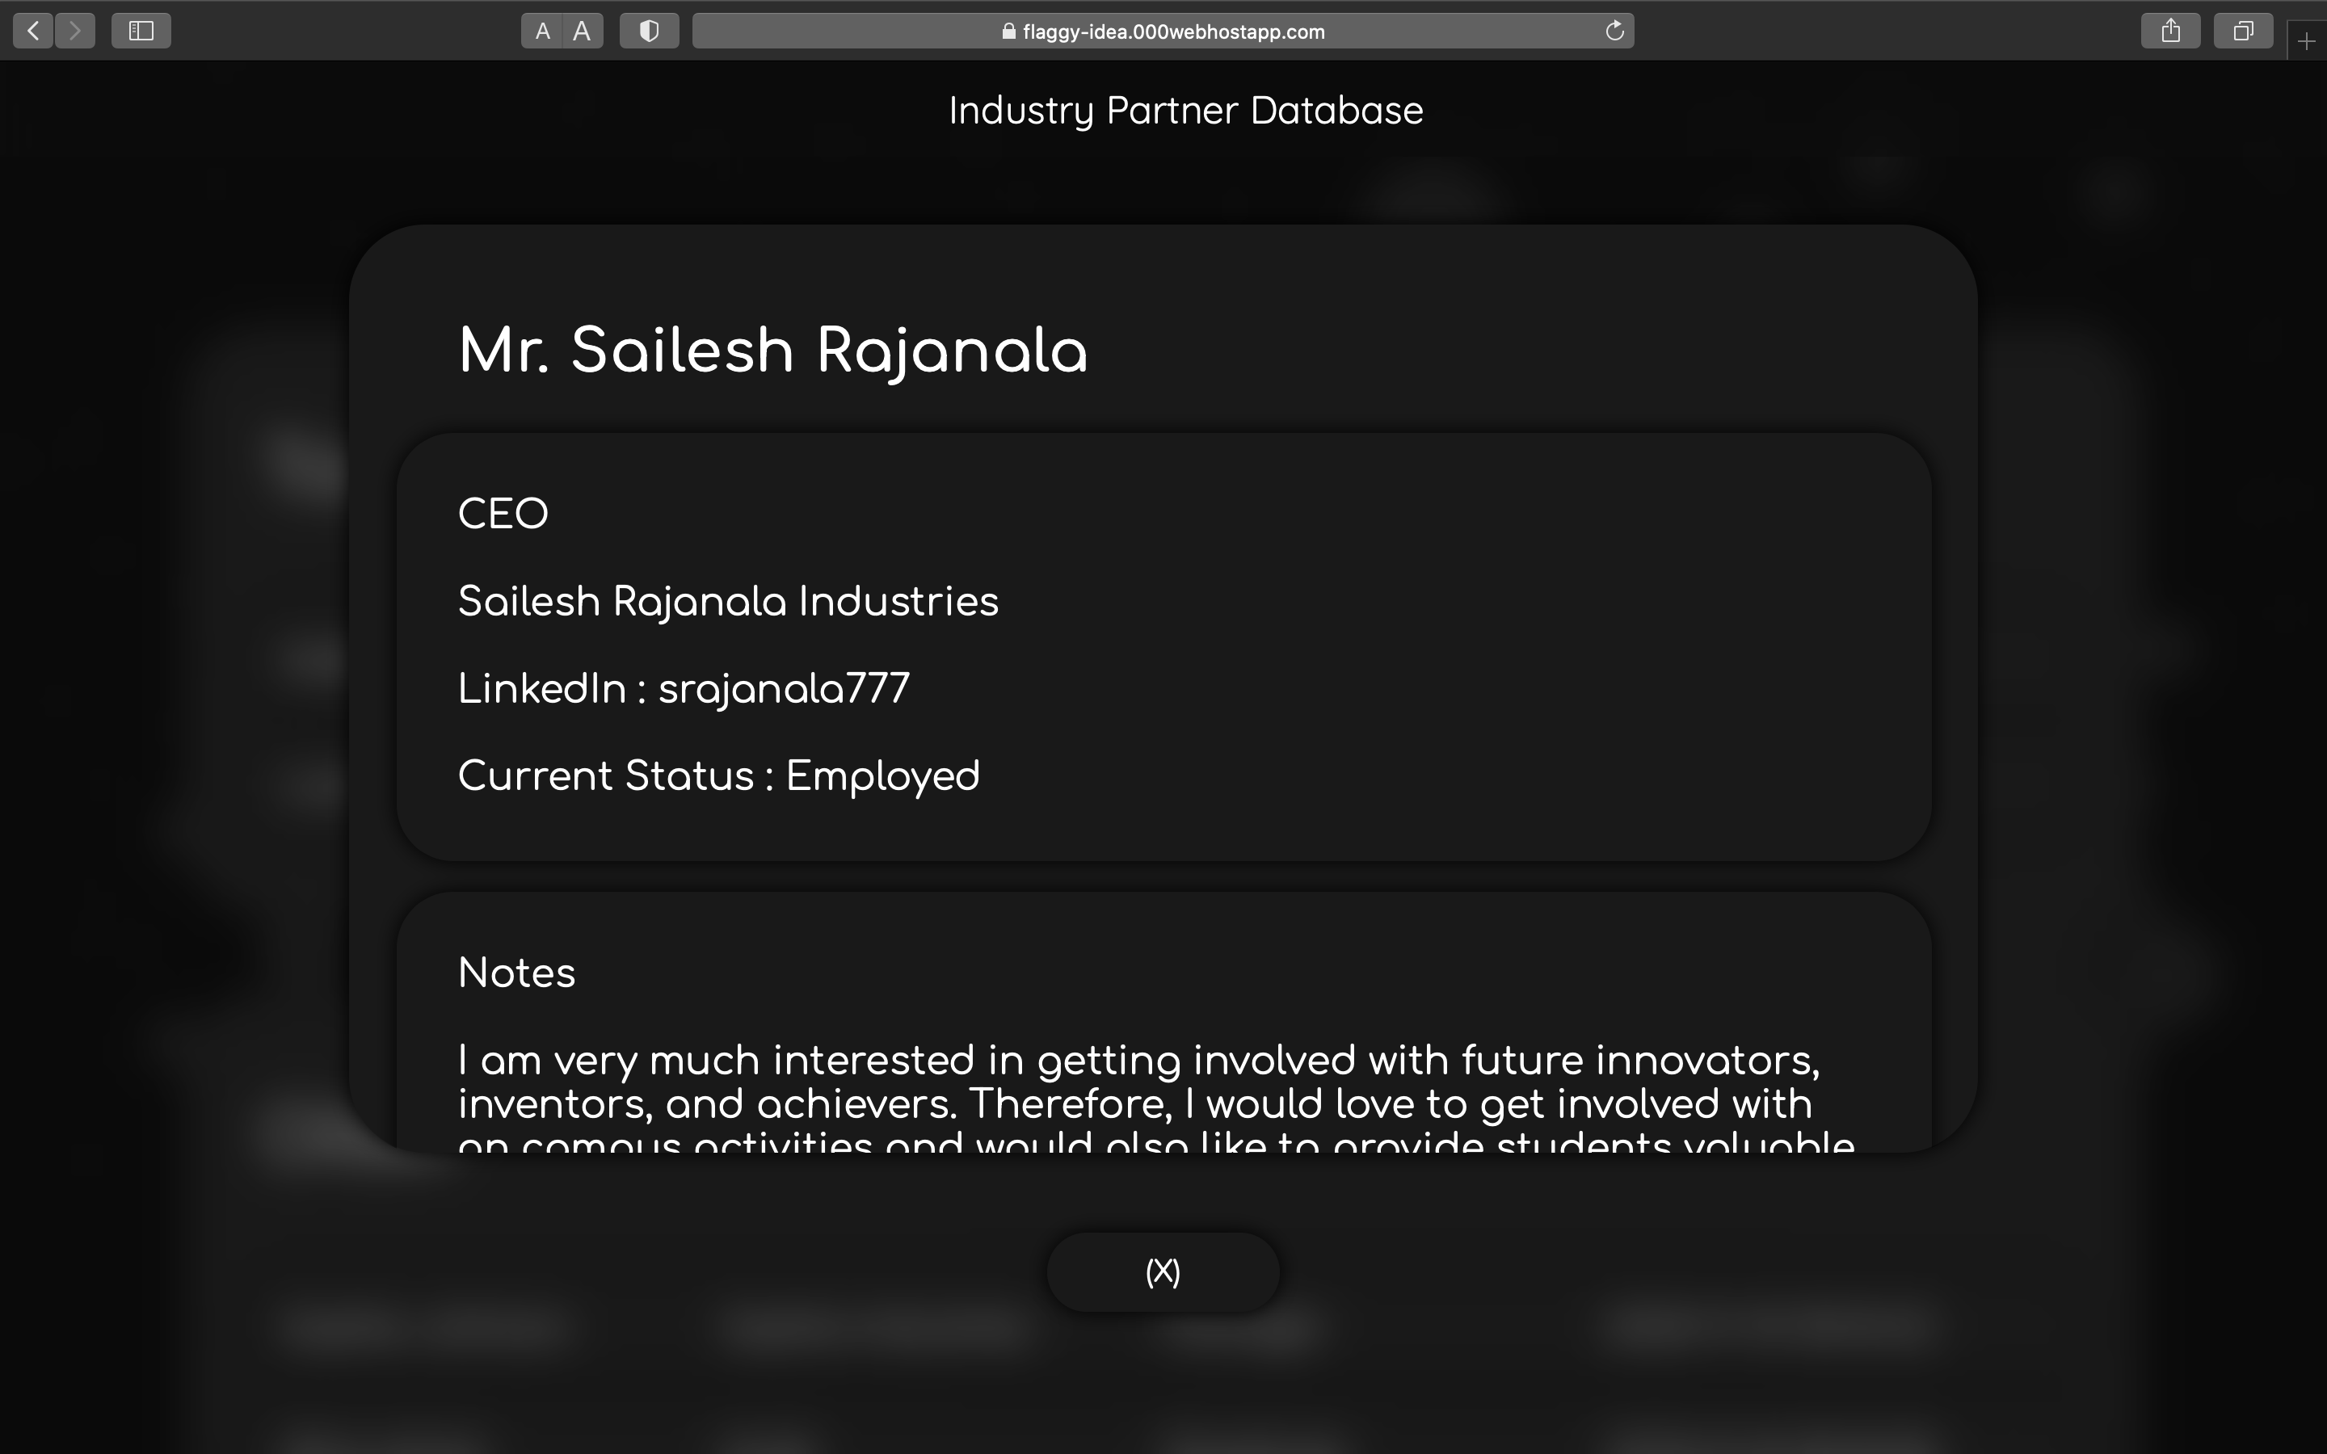

Slide 13
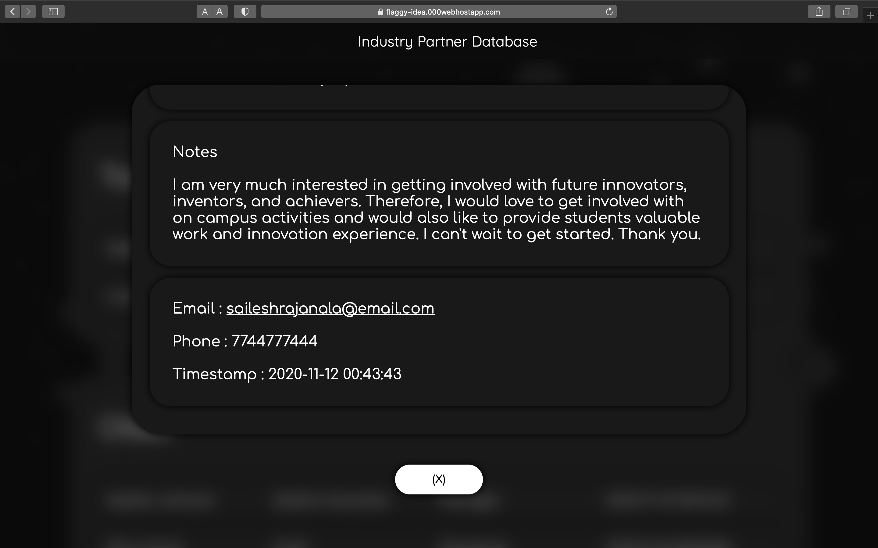

Slide 14
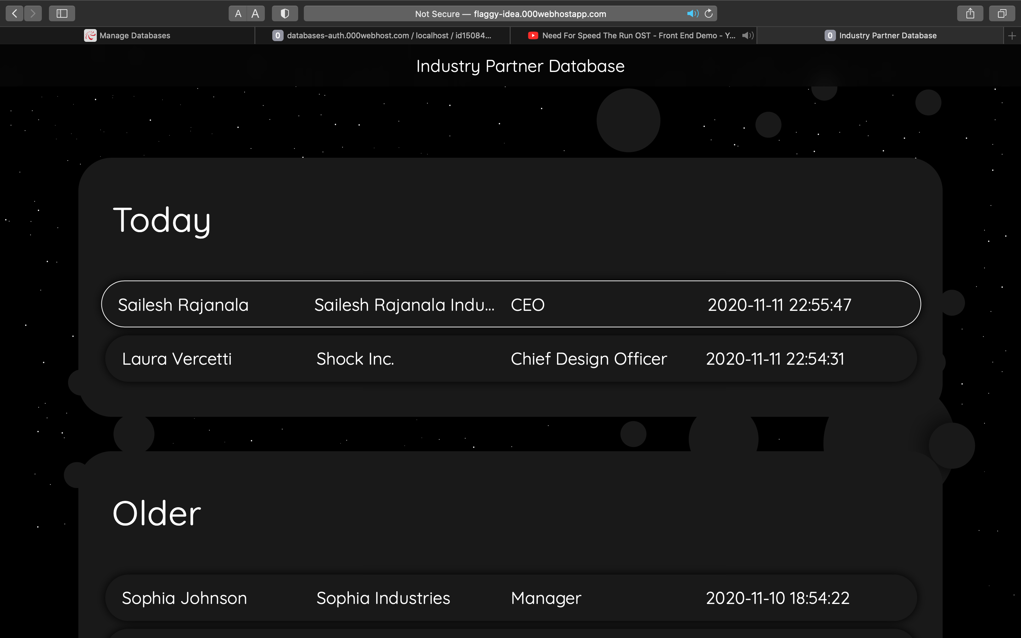
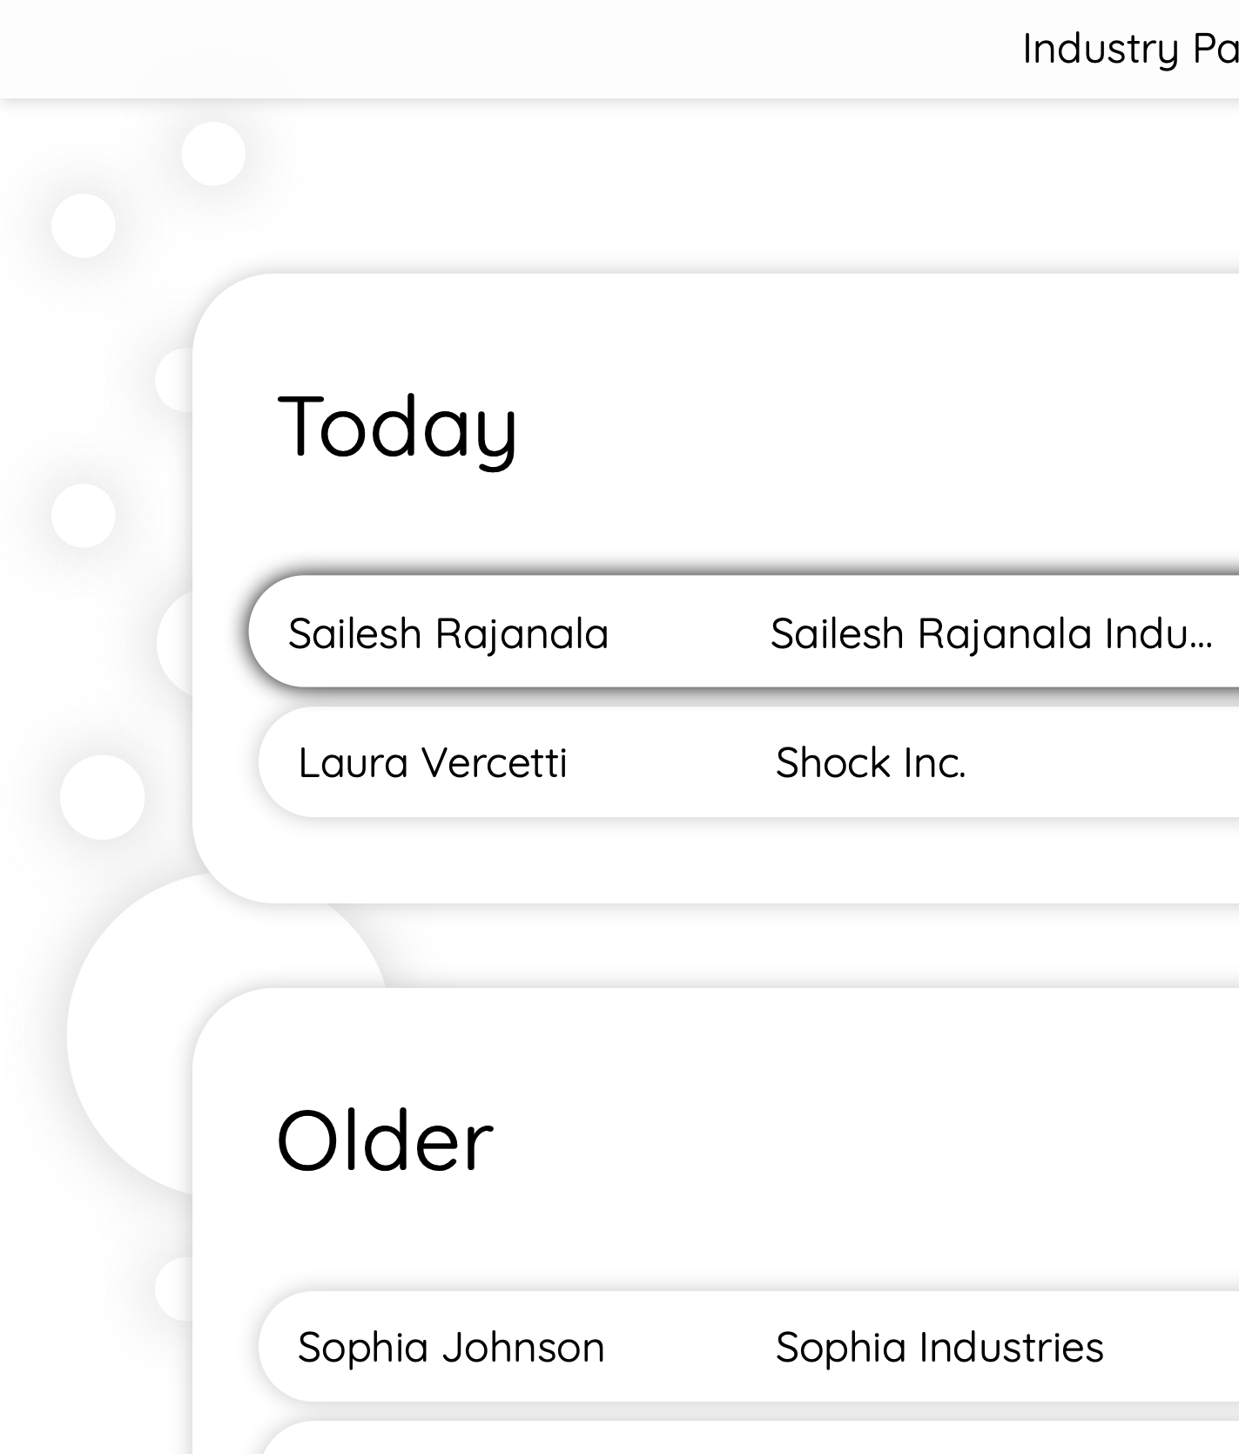

Slide 16
Webform
Testing
Priyanka Limbu
Deliverables
Computer Science
Time Keeper

Slide 17
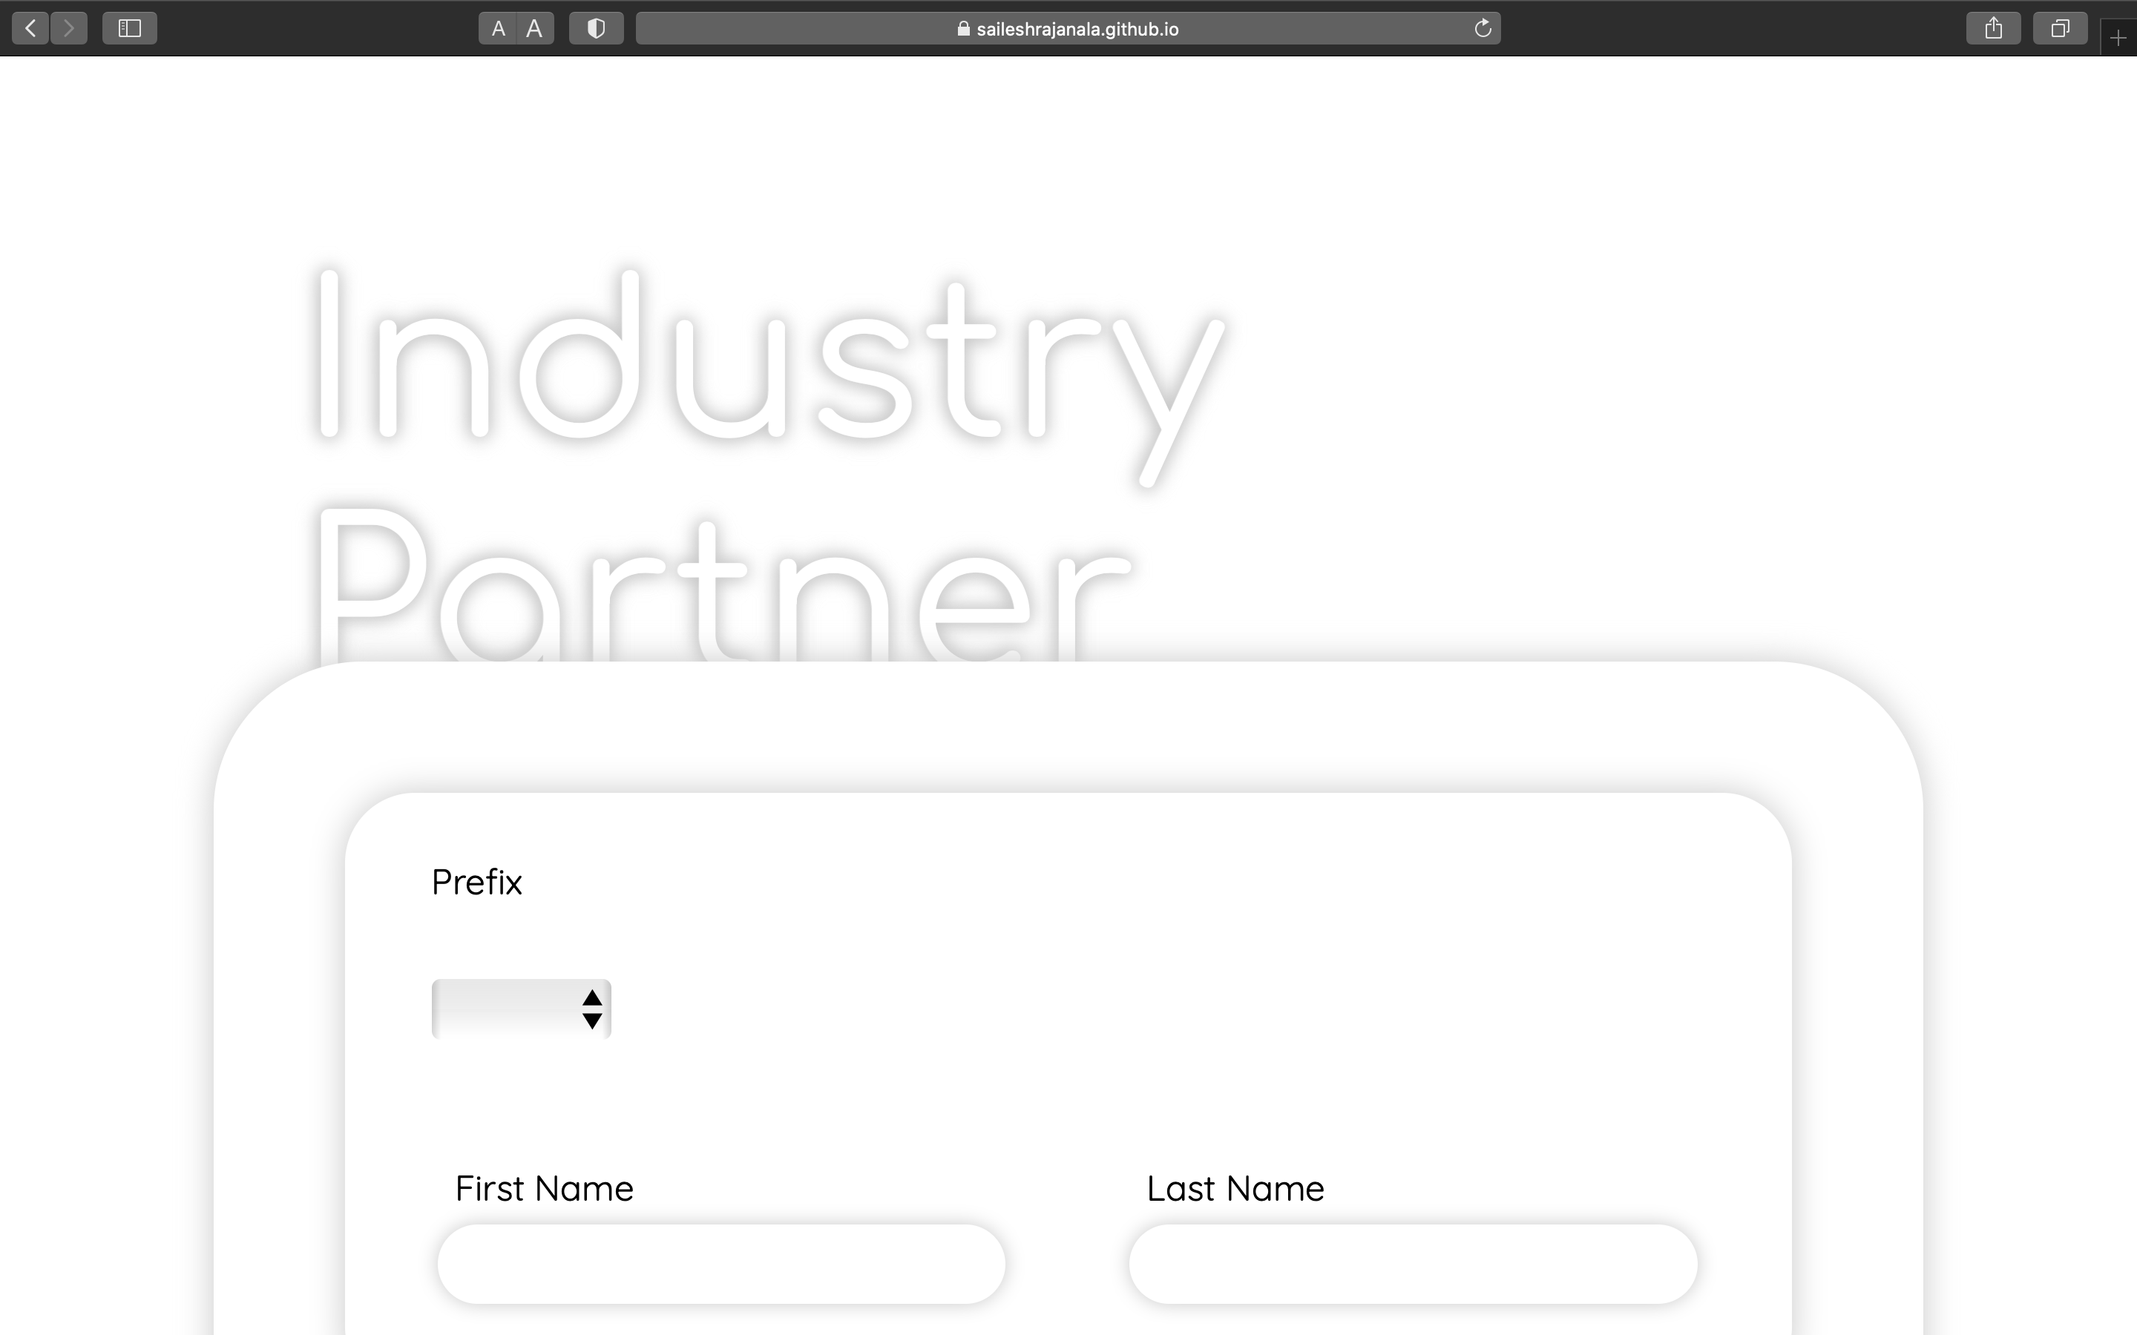

Slide 18
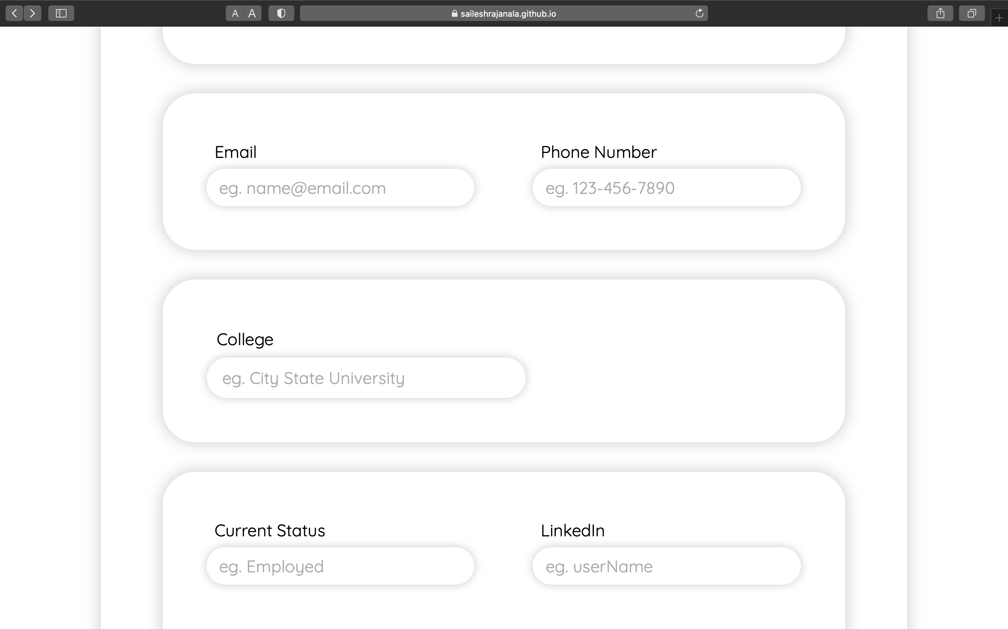

Slide 19
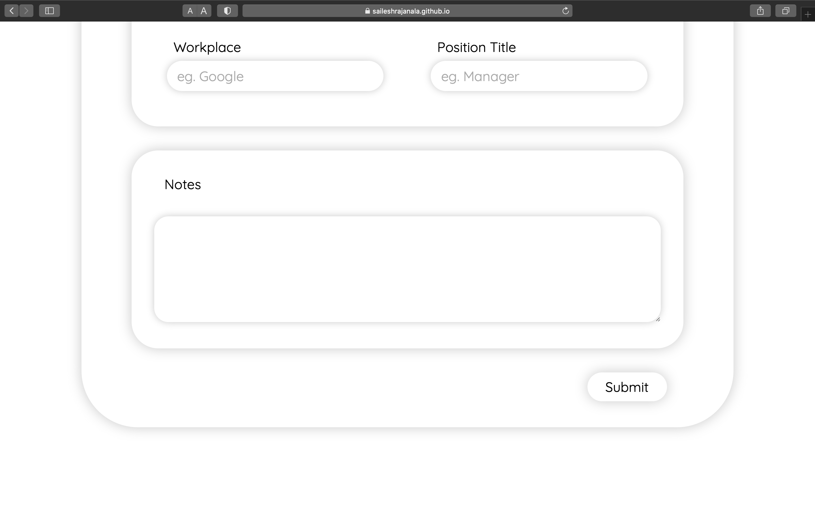

Slide 20
Test cases

Slide 21
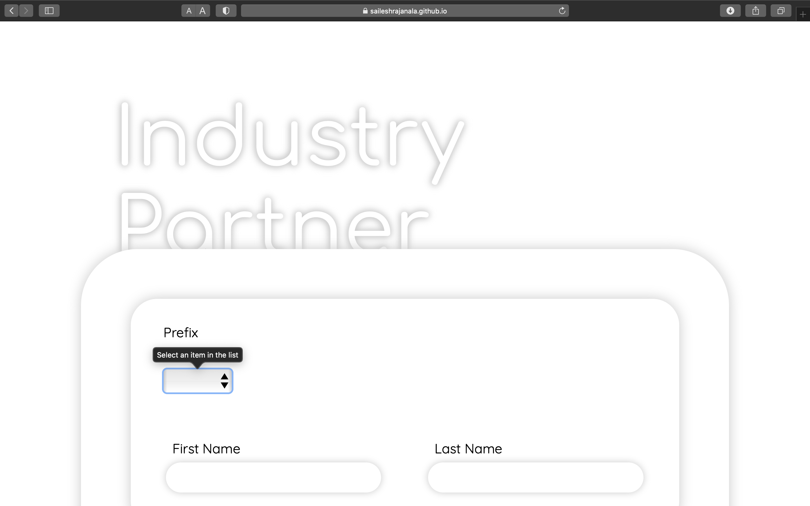
Submitting an empty form

Slide 22
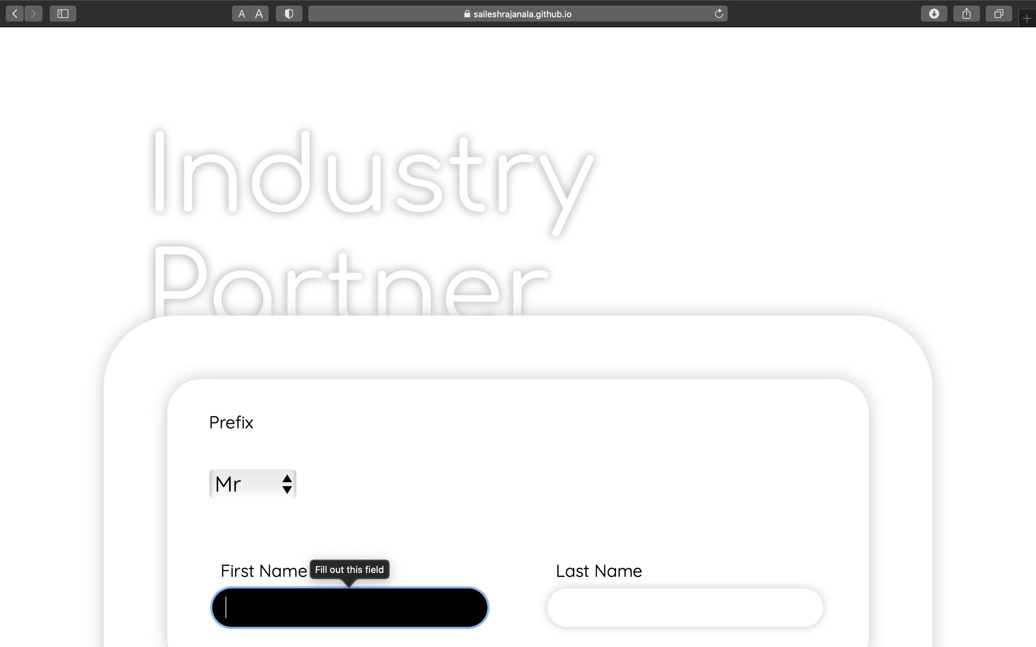
Submitting a partially filled form

Slide 23
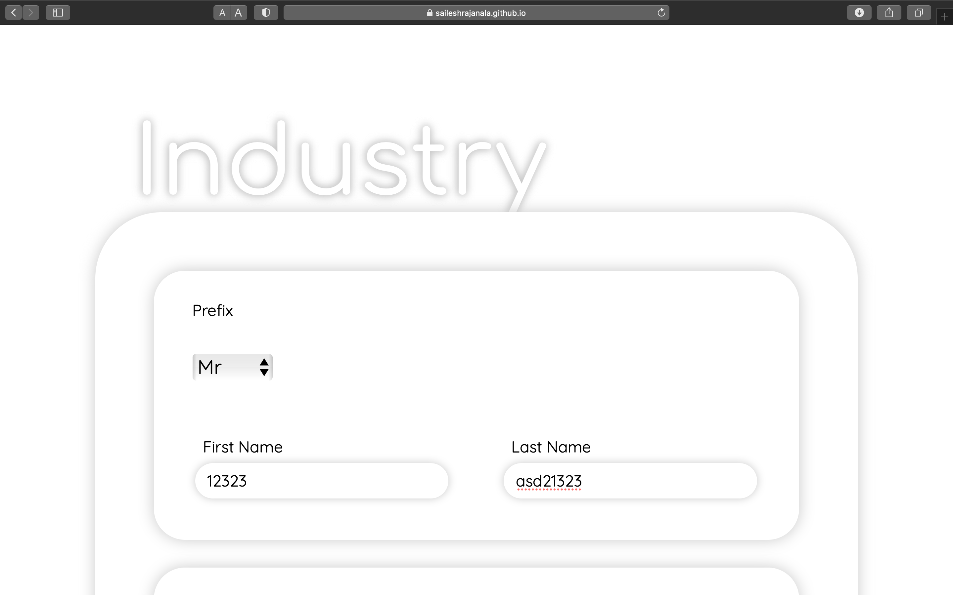
Invalid Name entries

Slide 24
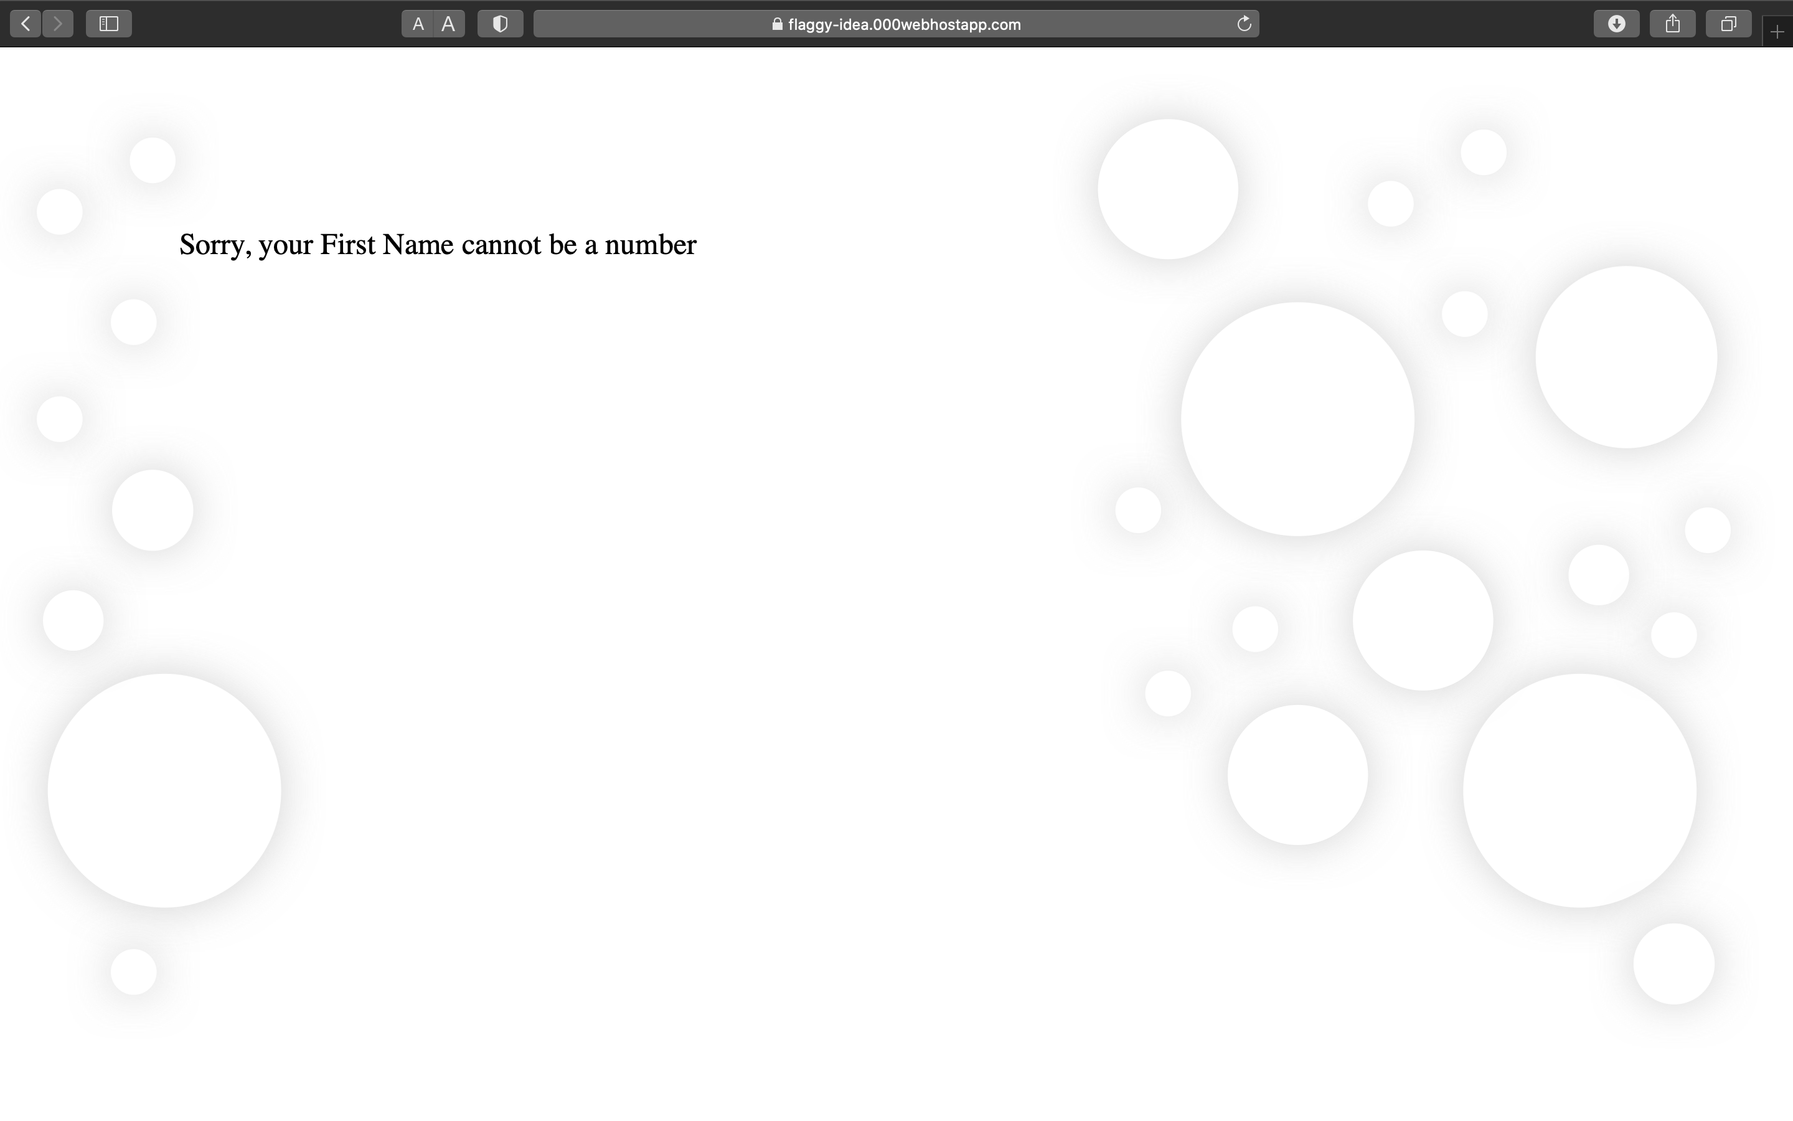
Error Message for a bad first name

Slide 25
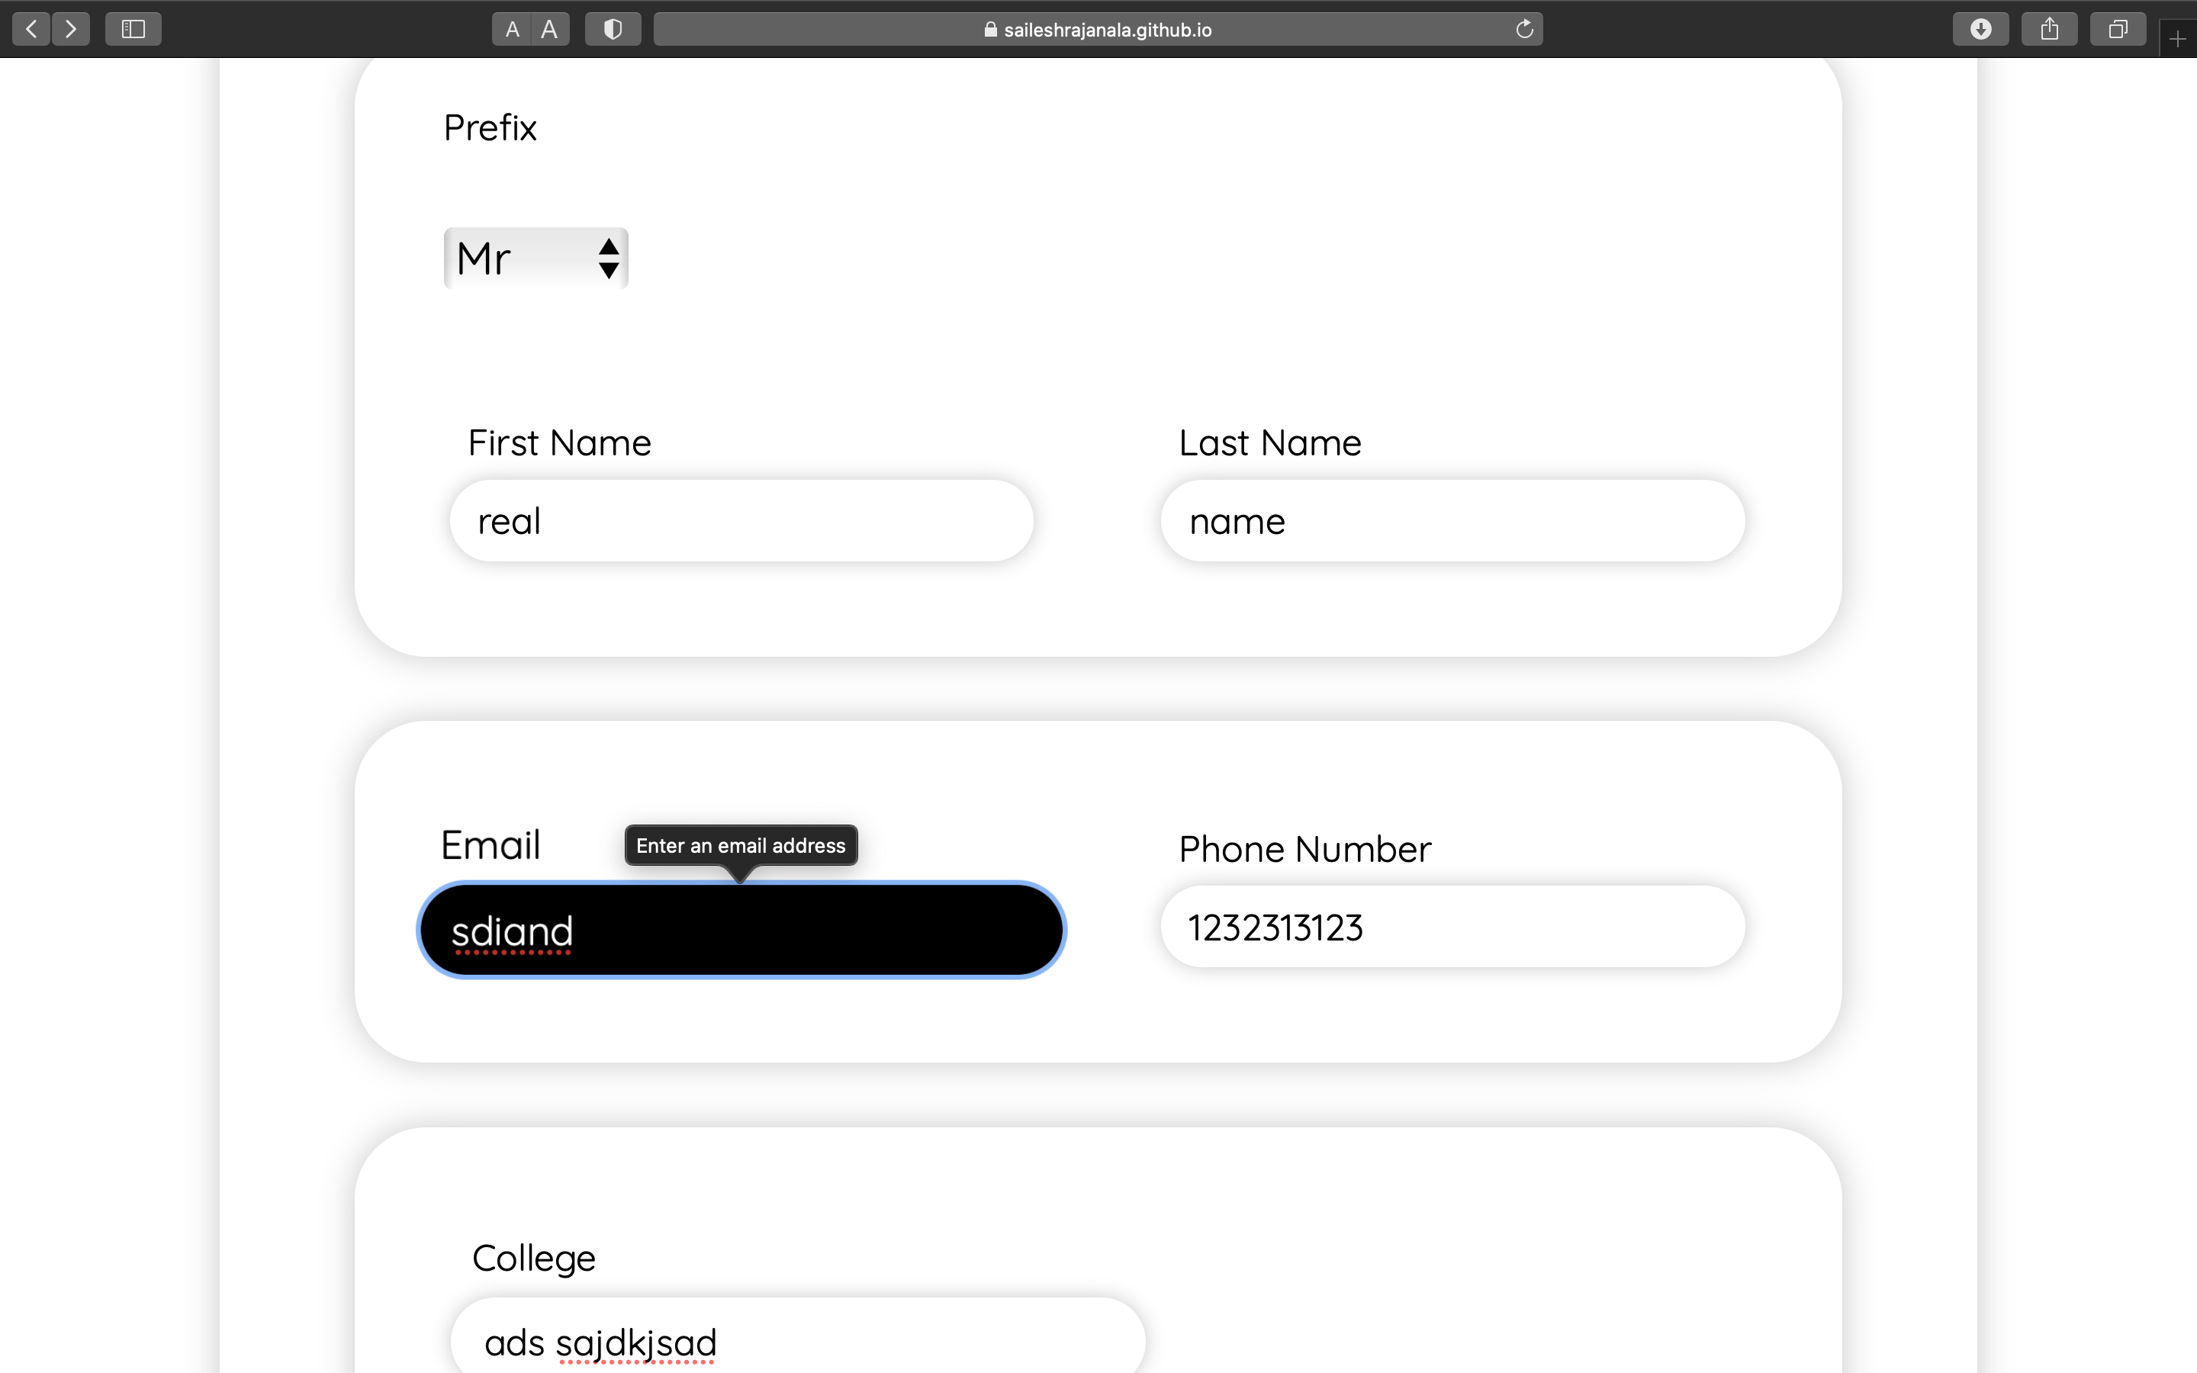
Invalid Email Entry

Slide 26
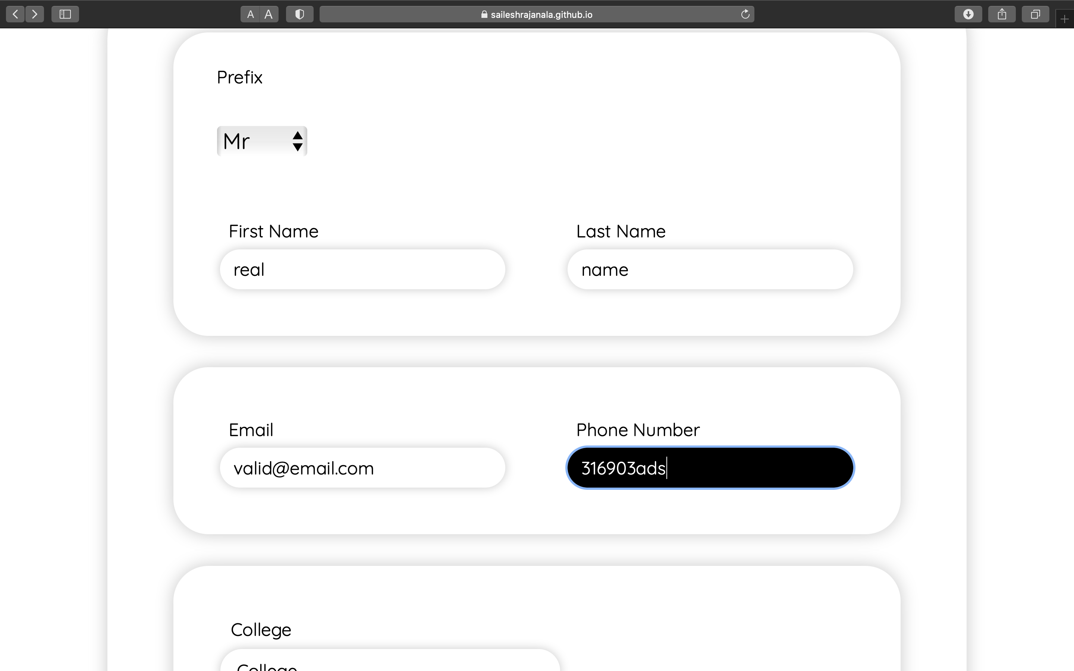
Invalid Phone Number Entry

Slide 27
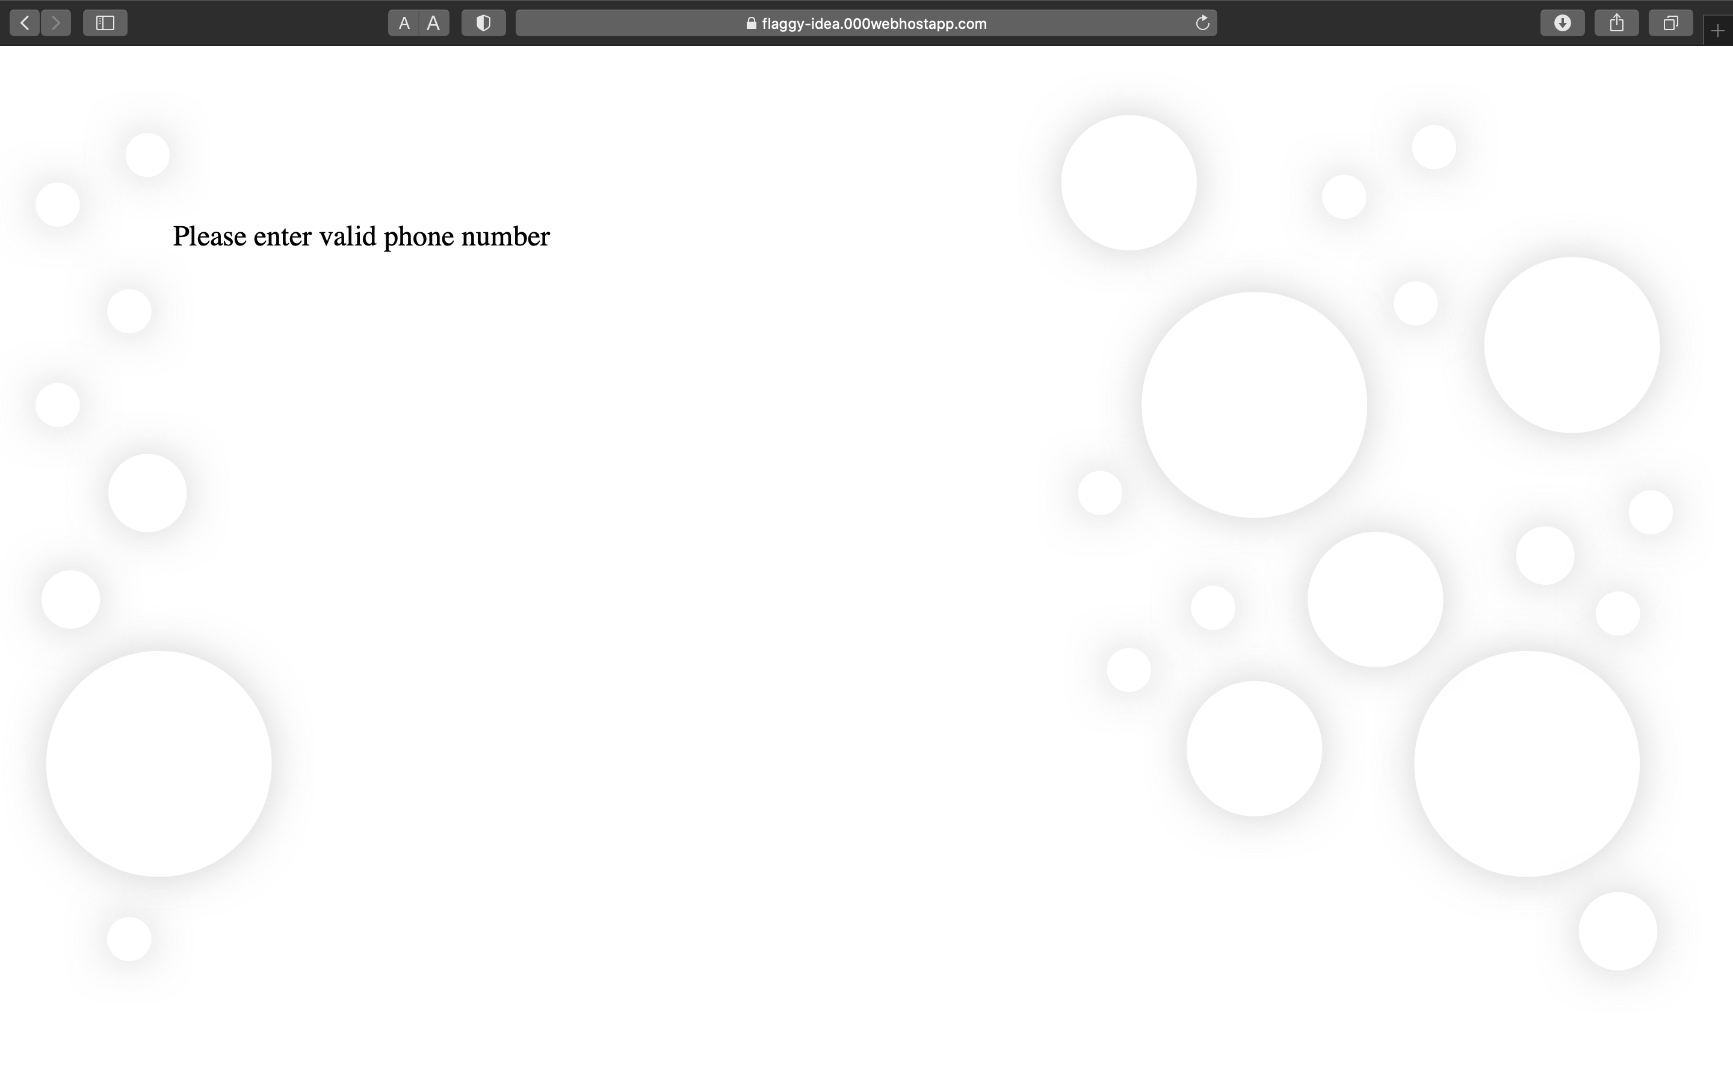
Error for an Invalid Phone Number Entry

Slide 28
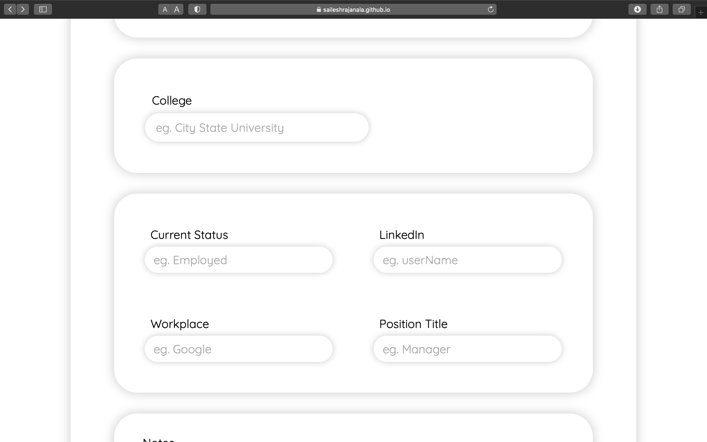
Optional Entries

Slide 29
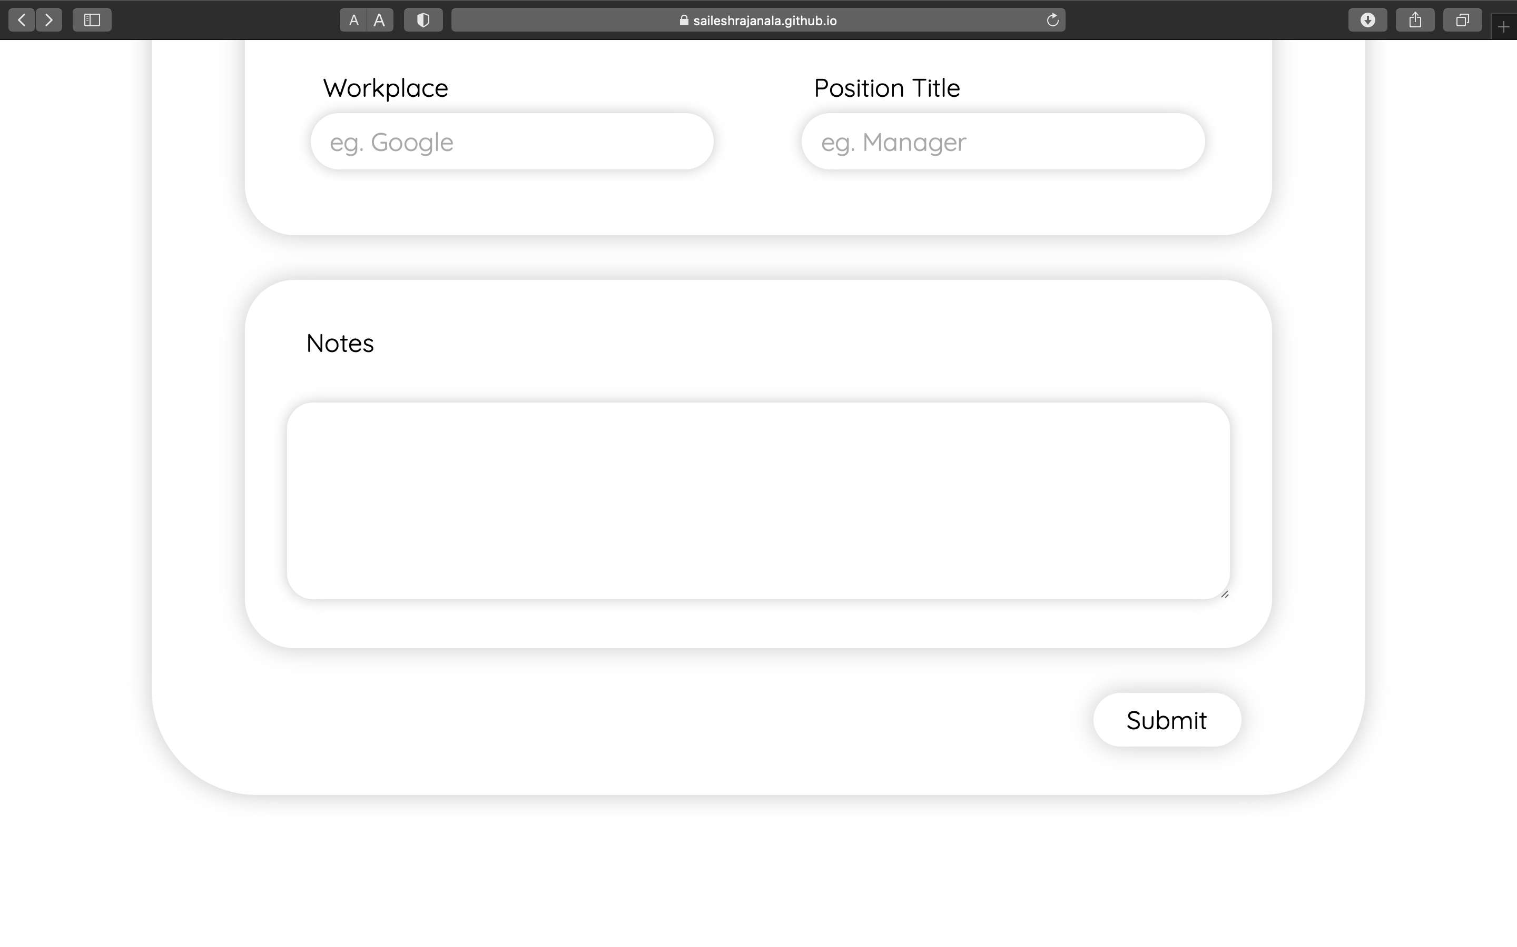
Optional Entries

Slide 30
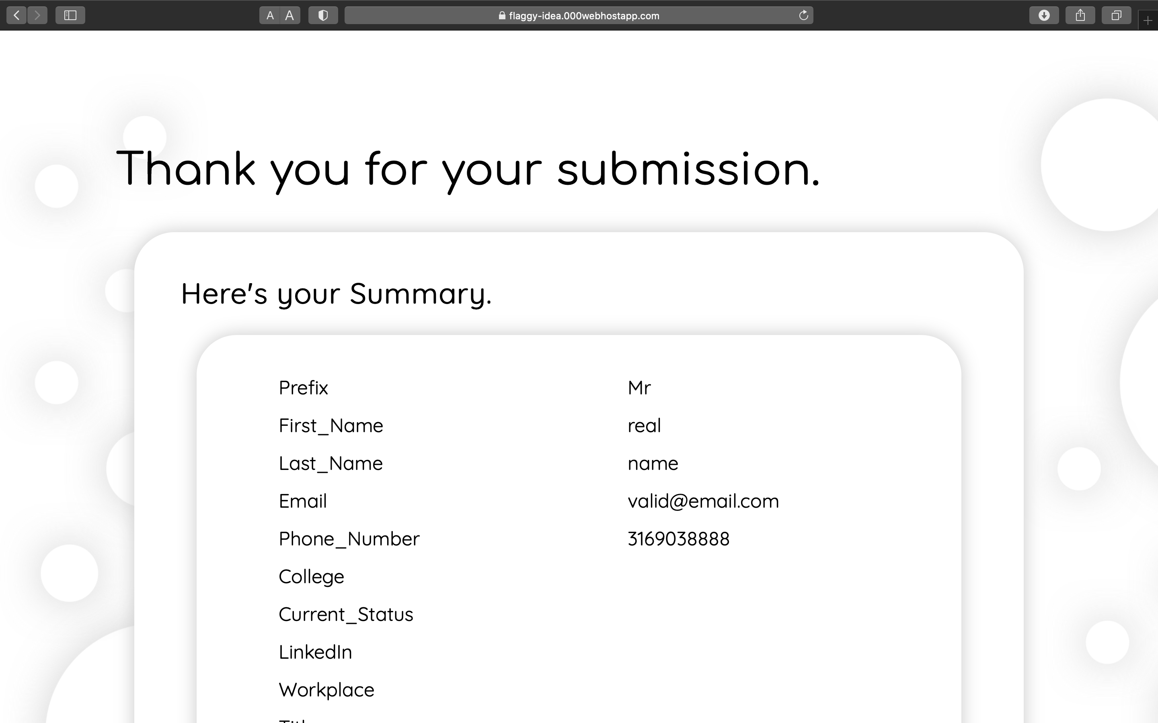

Slide 31
Testing
Cross Browser Compatibility
Webform must work and look similarly across different browsers
~
Mobile Responsiveness
Webform should be optimized for smaller screens
~
Form Fields Validation
Strict Detection of Invalid Entries on client-side using Javascript

Slide 32
Deliverables
WebForm
The webpage that retrieves data from database is a major deliverable
Webpage for Form Submission
The webpage that summaries user’s submission
The webpage that populates the Database

Slide 34

Backend Challenges
Testing
Subash
Acharya
Computer Engineering
Scribe, Backend

Slide 35
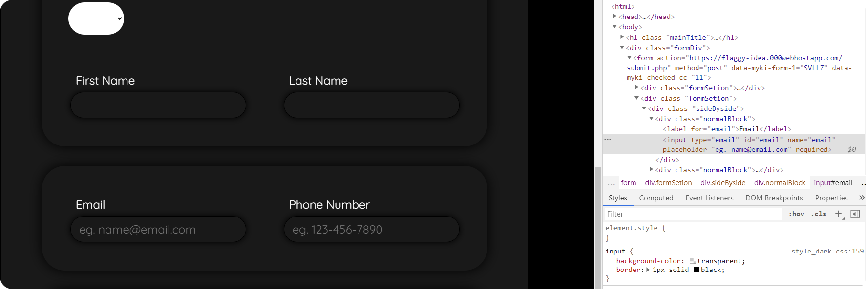

Slide 36
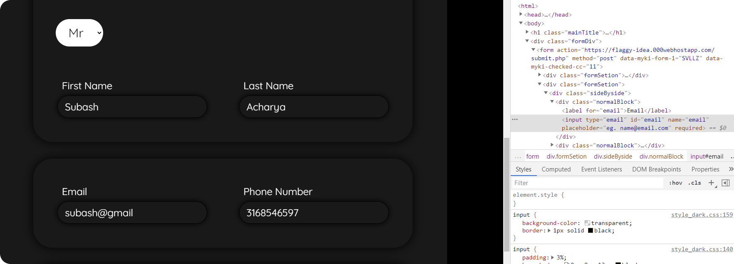

Slide 37
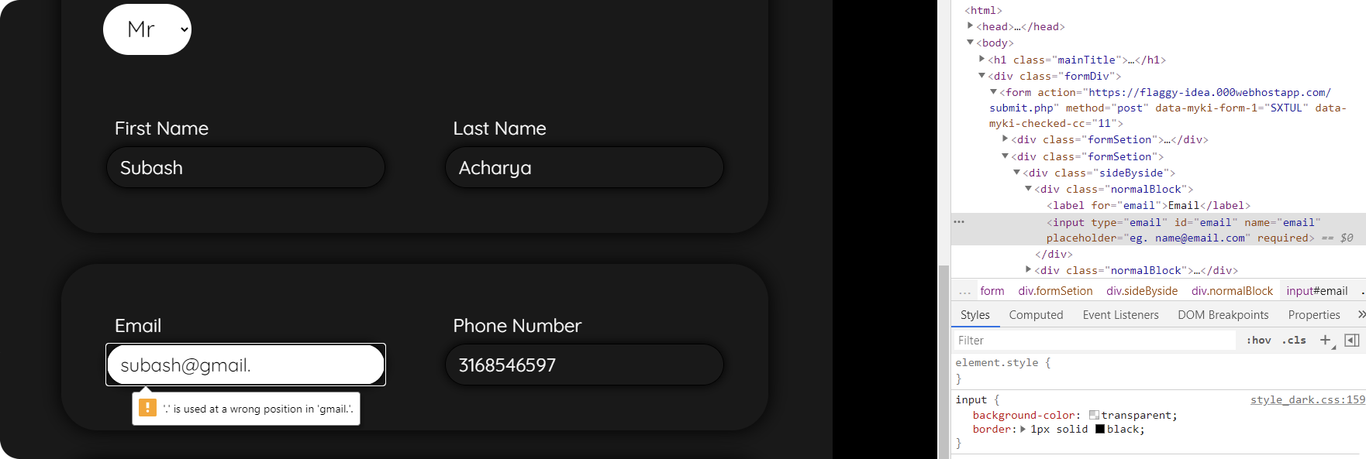

Slide 38
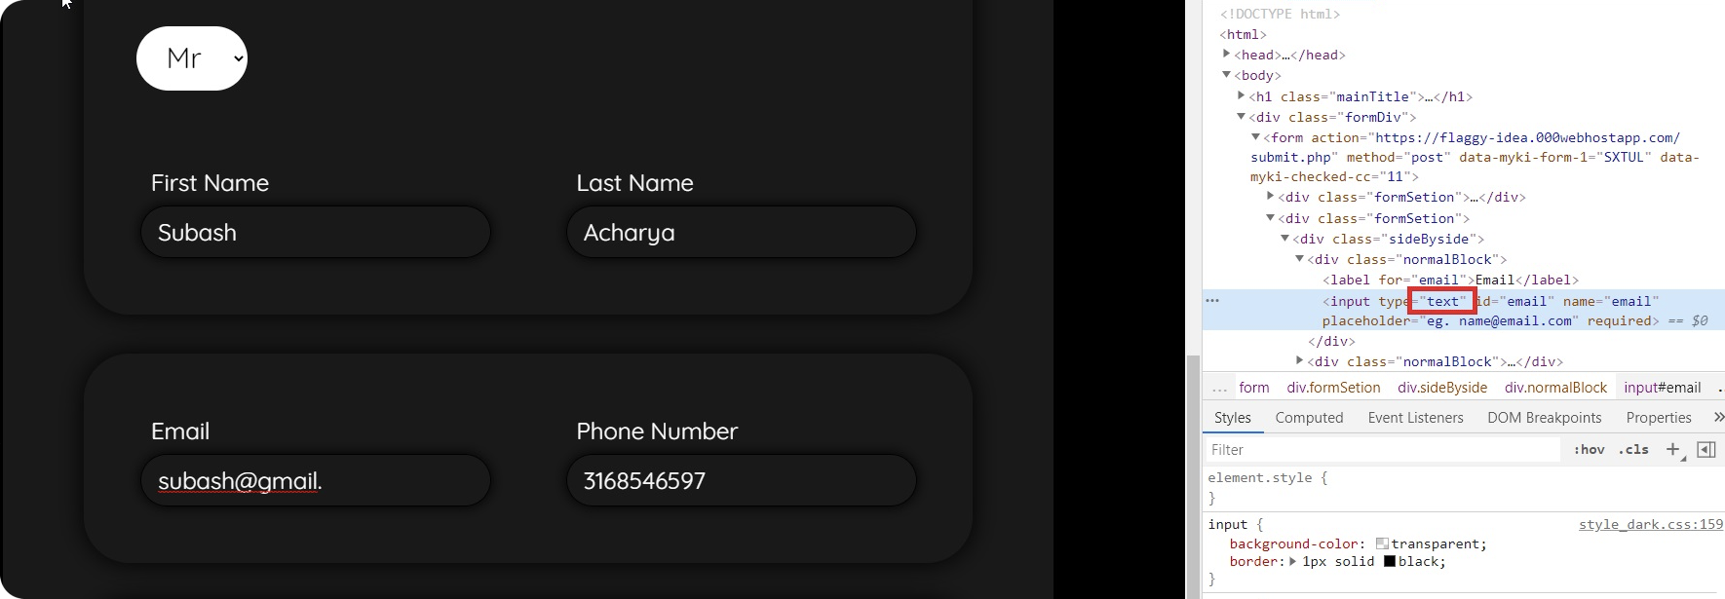

Slide 39
What we do?
PHP sanitization and validation

Slide 40
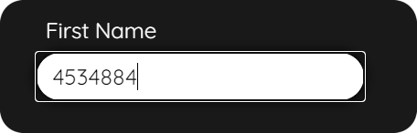
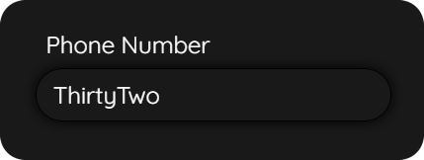
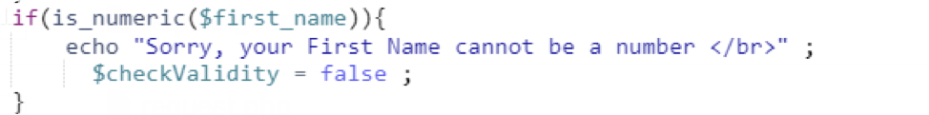
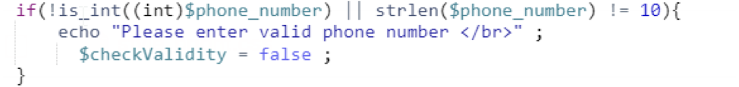
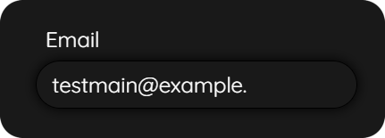
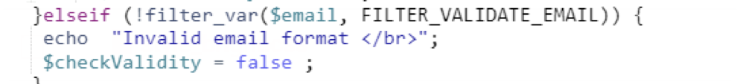
Challenges
Information entered is wrong type : -
Example : -
Testing : -
2) Information entered is wrong format : -
Example : -
Testing : -

Slide 41
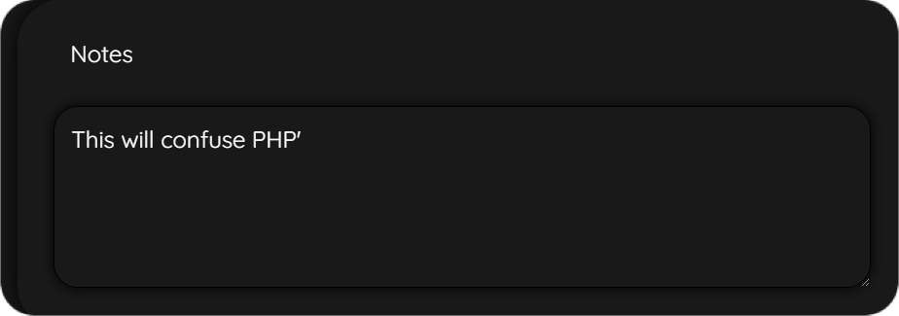
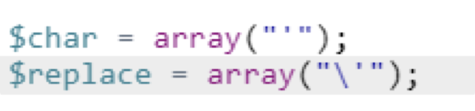
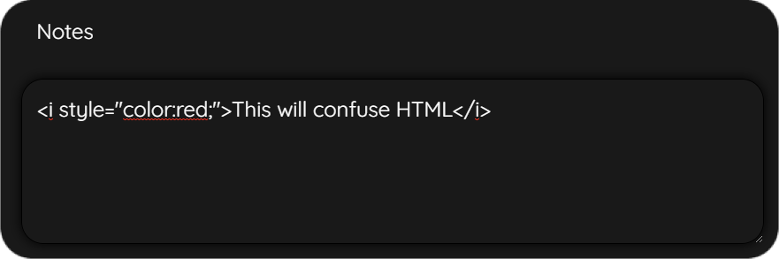
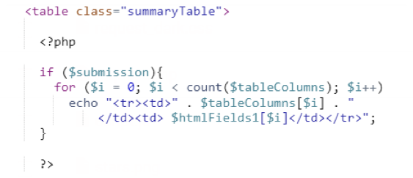

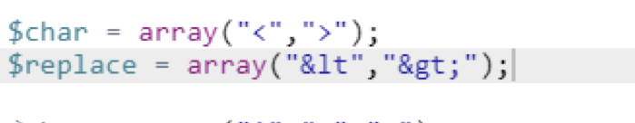
Example : -
3) Information entered consists of special
characters used by php
: -
Testing : -
4) Information entered consists of special
characters used by html
: -
Example : -
Result : -
Testing : -

Slide 42
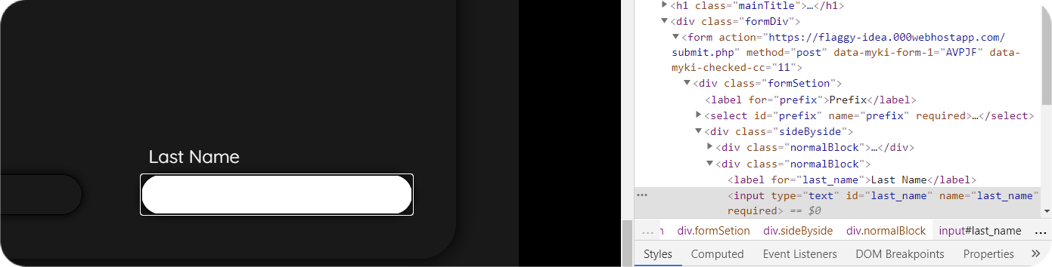
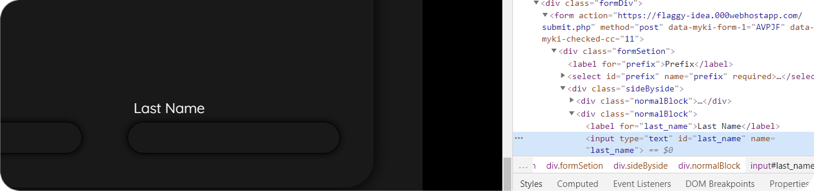
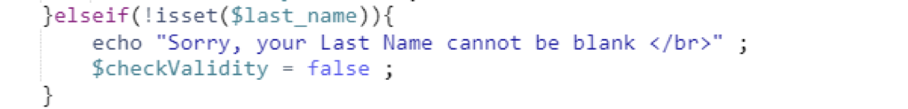
5) Black Field Is Submitted
Example : -
Testing : -

Slide 43
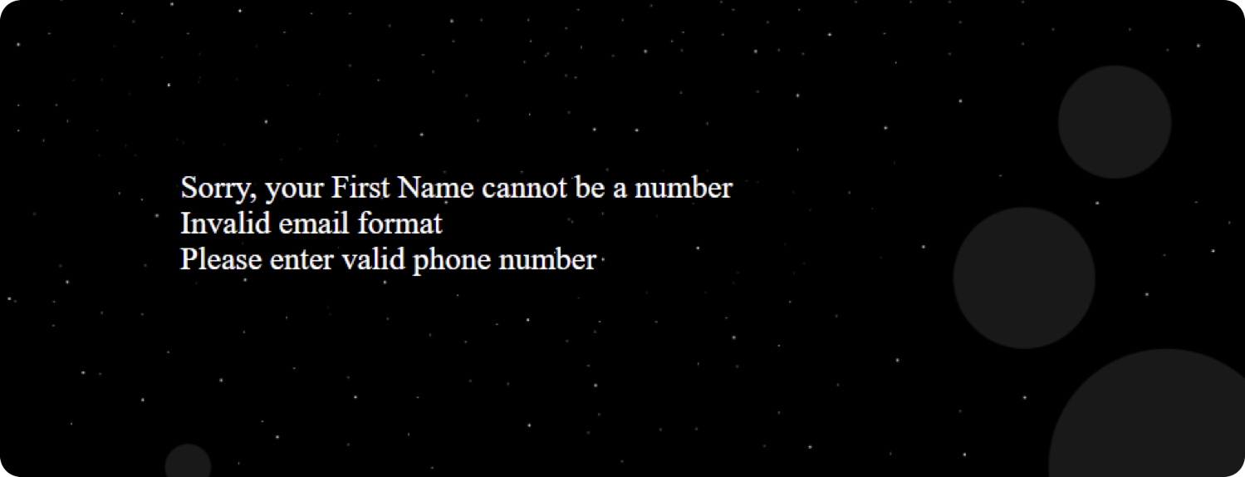
What went Wrong ?

Slide 44
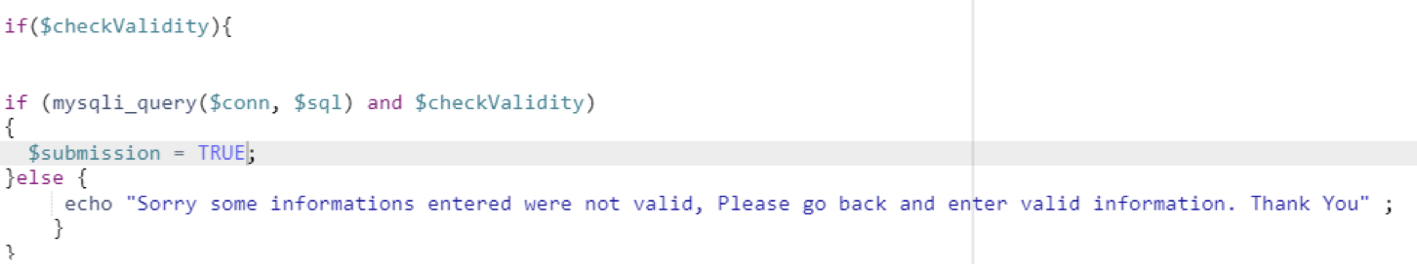
What if information passes sanitization but fails to create MySQL query ?
User is tempering with our website
Default Error

Slide 46

Data Retrieval
Testing
Shiva Karki
Deliverables
Computer Science
Facilitator

Slide 47
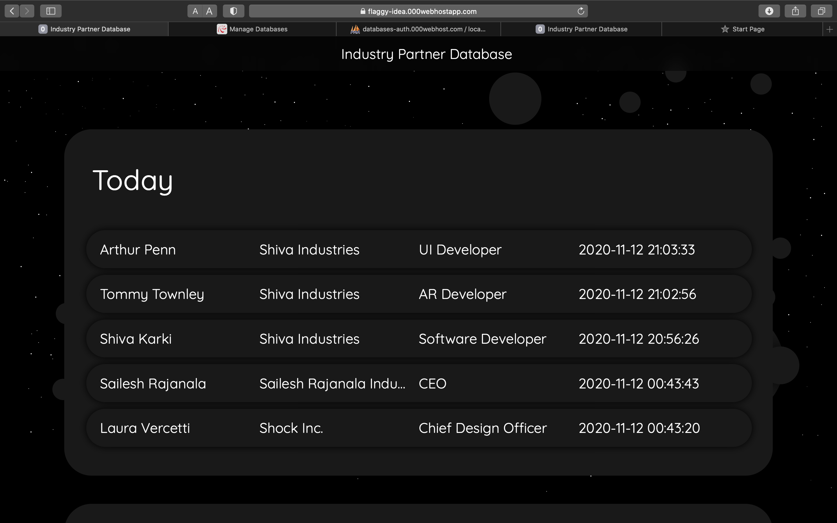

Slide 48
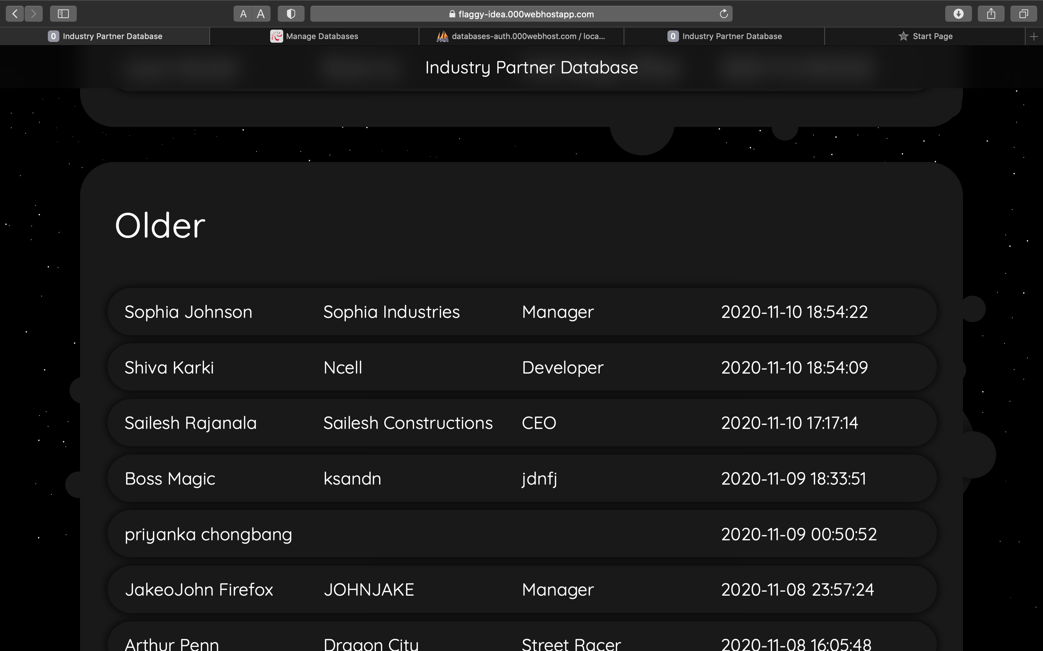

Slide 49


Slide 50
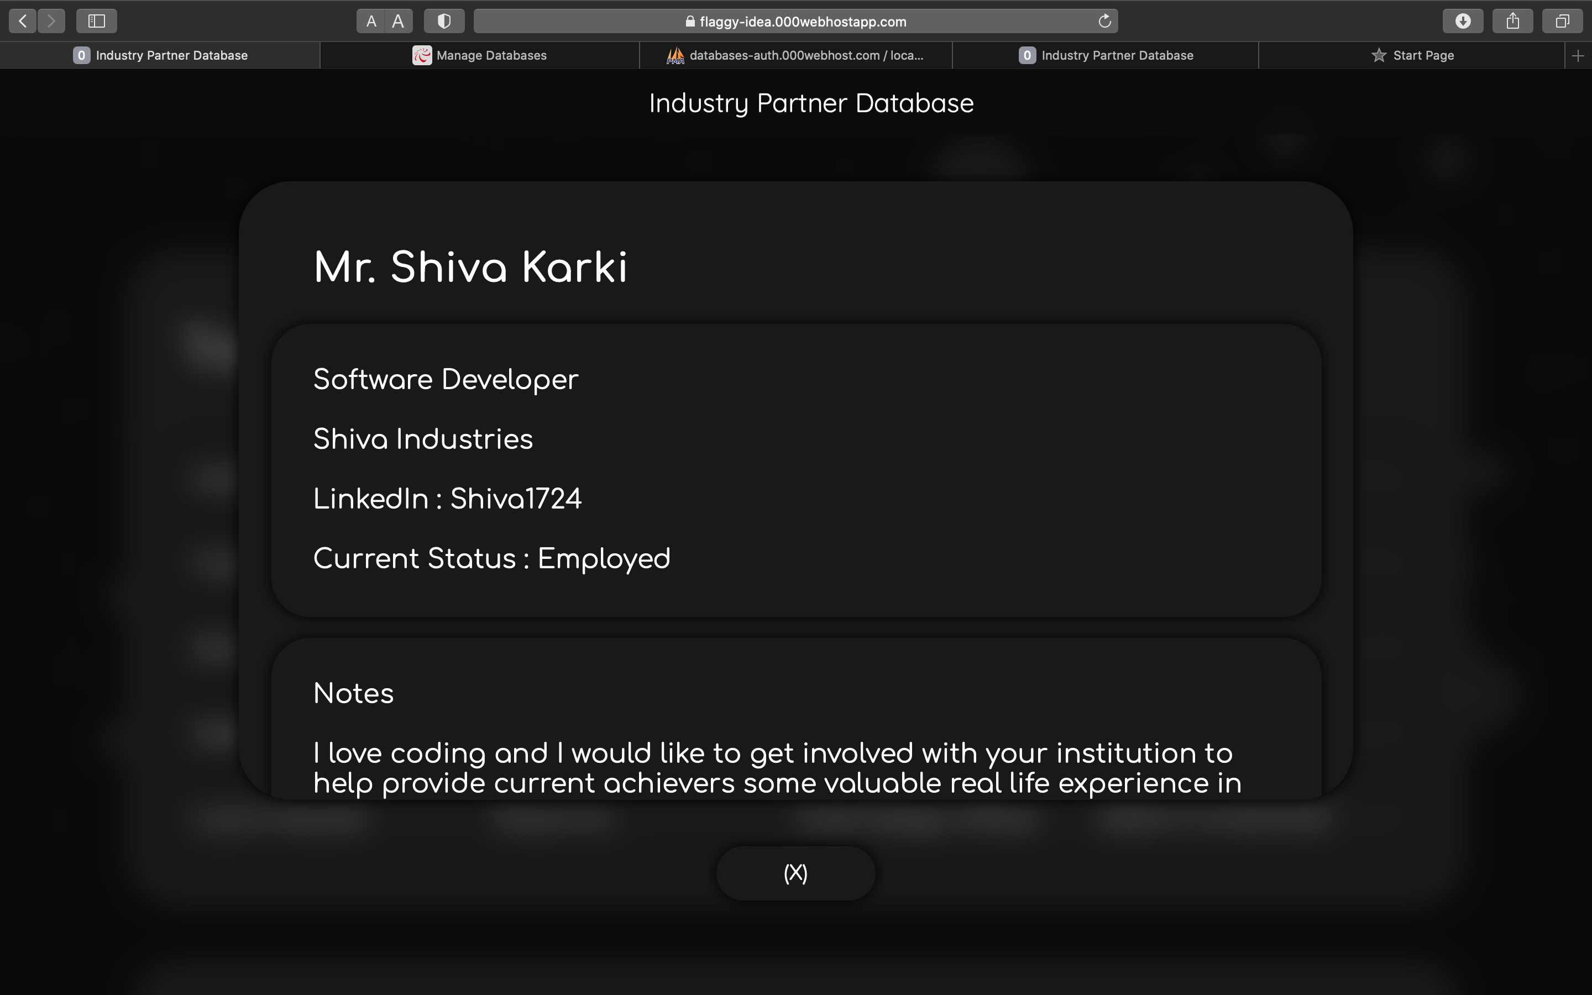

Slide 51
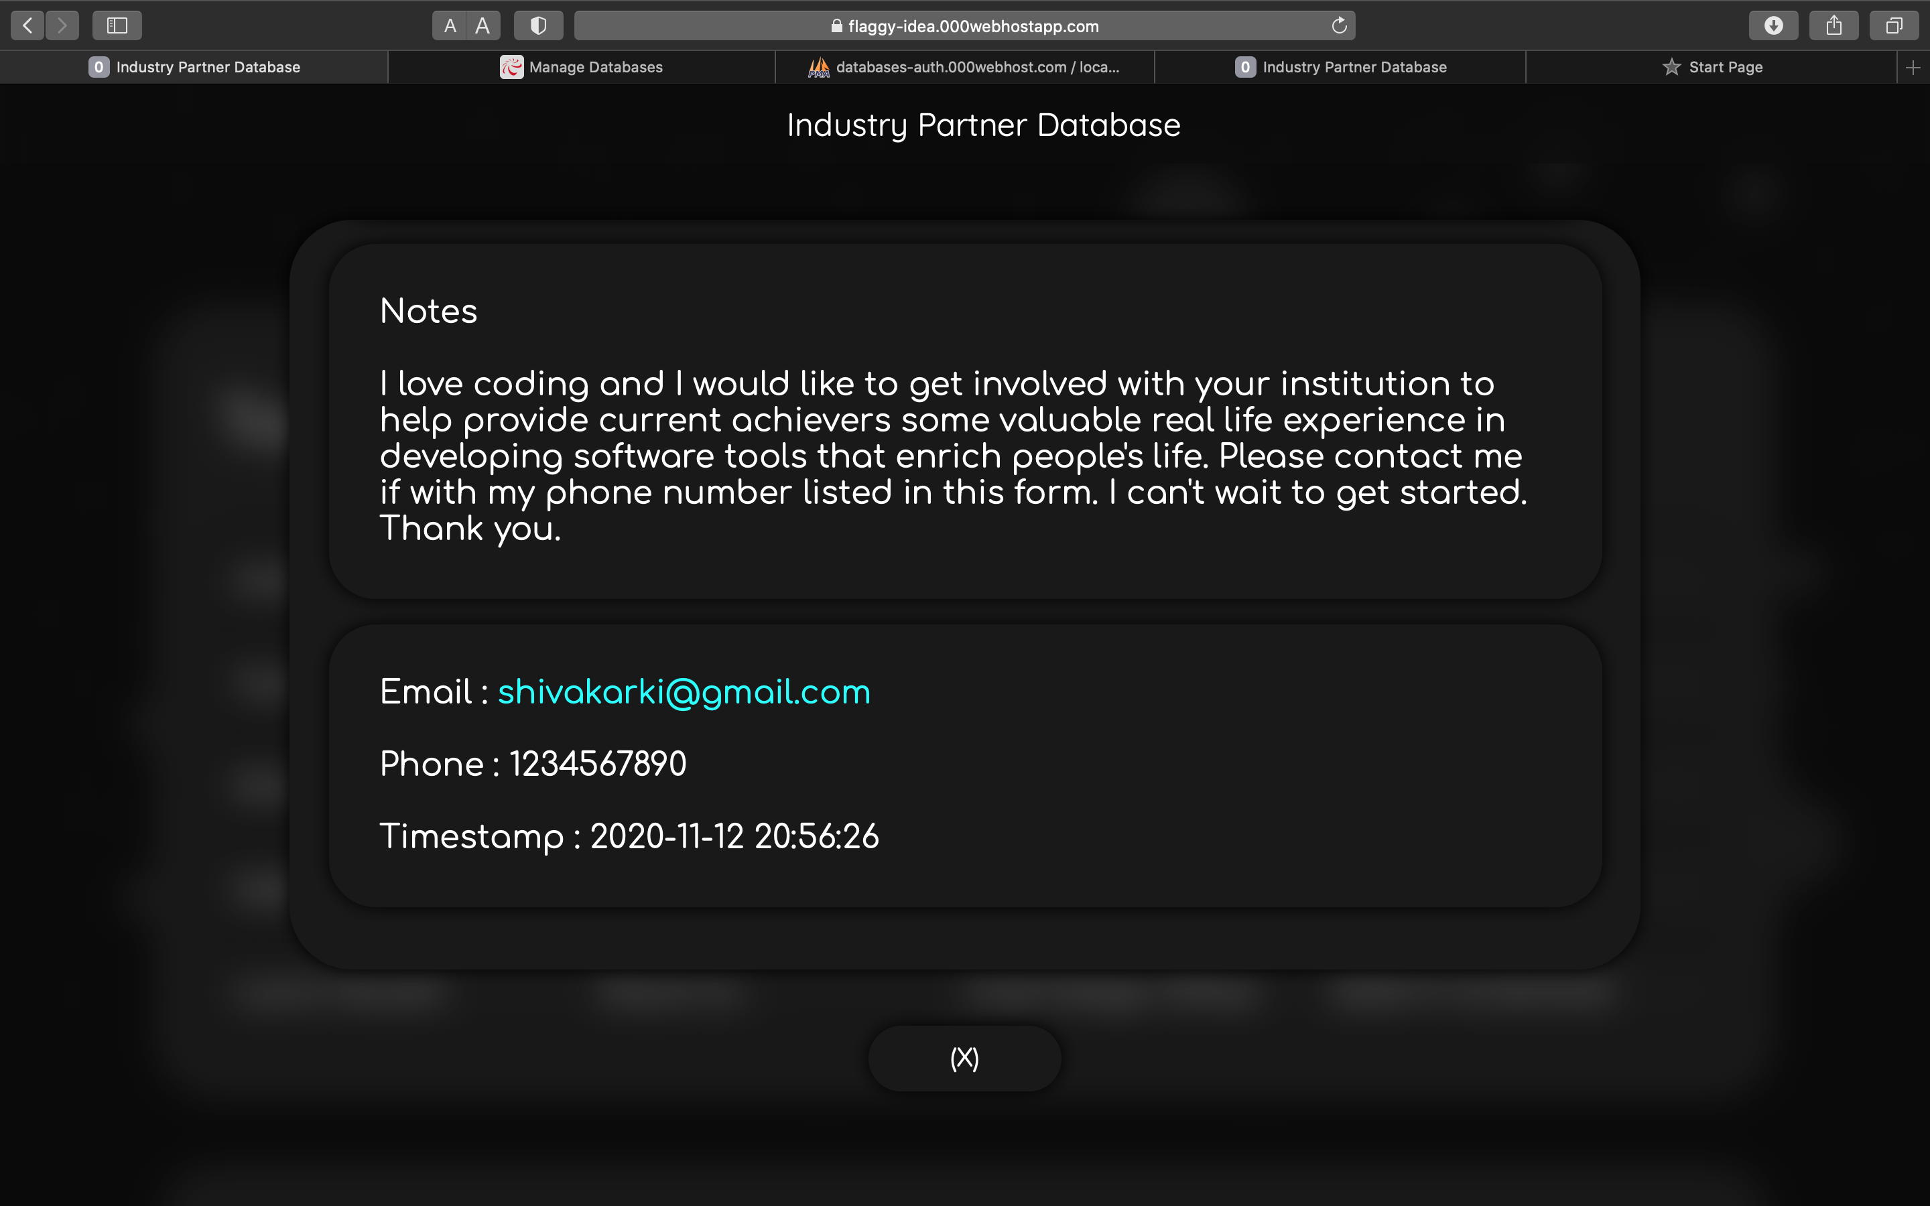

Slide 52


Slide 53


Slide 55
Testing
Cross Browser Compatibility
Webpage looks and works in a similar way across different browsers
~
Mobile Responsiveness
Webpage supports smaller devices (mobile phones)

Slide 56
Compatibility (Desktop)
Operating System
Web Browser
Windows 7 or later
Google Chrome 76 or later
Mac OS X Mavericks or later
Safari 9 or later
64-bit Ubuntu 14.04 or later
FireFox 83 or later
Fedora Linux 24 or later
Microsoft Edge 17 or later
Debian 8 or later

Slide 57
Compatibility (Mobile)
Operating System
Web Browser
Android 5 (Lollipop) or later
Google Chrome 86 or later
iOS 9 or later
iOS Safari 9 or later
Android WebView : Chromium 81 or later
Samsung Internet 12.0 or later

Slide 58
Deliverables
Webpage
The webpage that retrieves data from database is a major deliverable.

Slide 60
User Stories
Multiple entries.
Updated entries.
Multiple entries from multiple accounts.

Slide 61
Test Cases
Using with three main browsers chrome, mozilla, and safari. (latest release version).
Using on mobile browser apps.
Entry capacity.

Slide 62
Solutions
Adding test users to the form.
Creating rules for web-forms.
Acceptable/Unacceptable elements in web-forms.

Slide 63
Questions?
?

Slide 64
Thank you

